Slide 1
Student Training
Travel Information Centre
Suzanne Kukko, North Shore Tourism Coordinator
July 13th, 2021

Slide 2
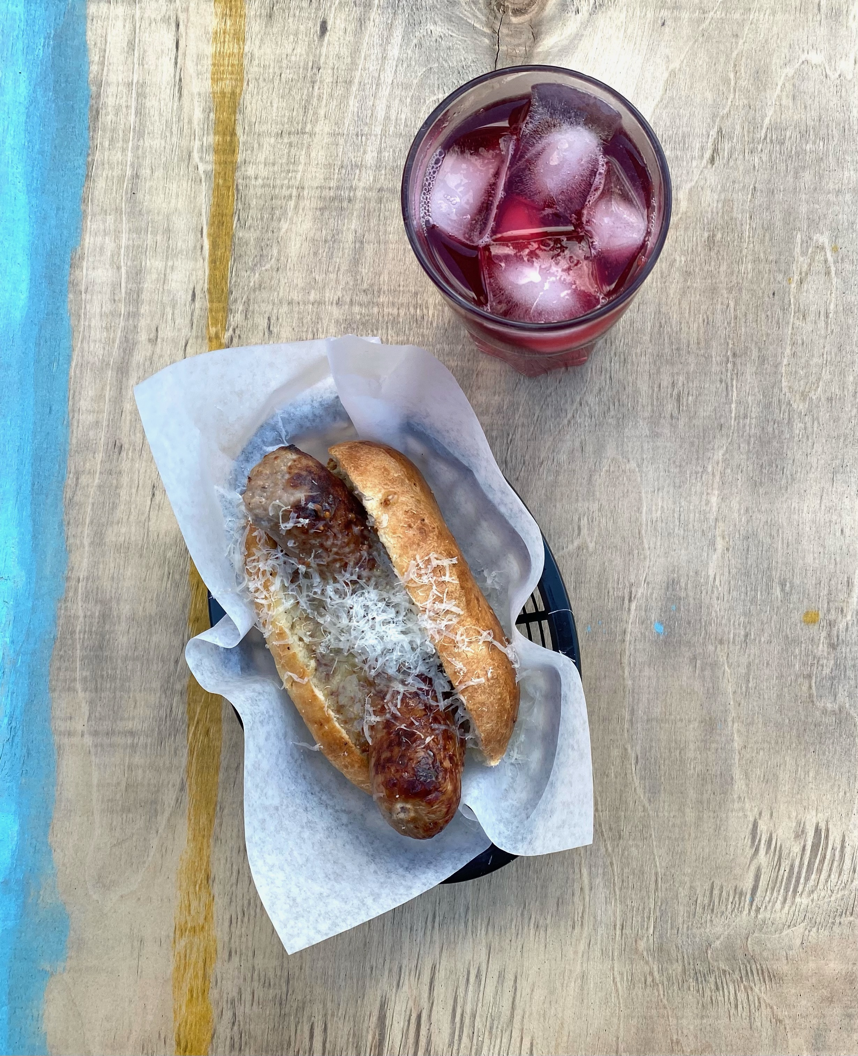
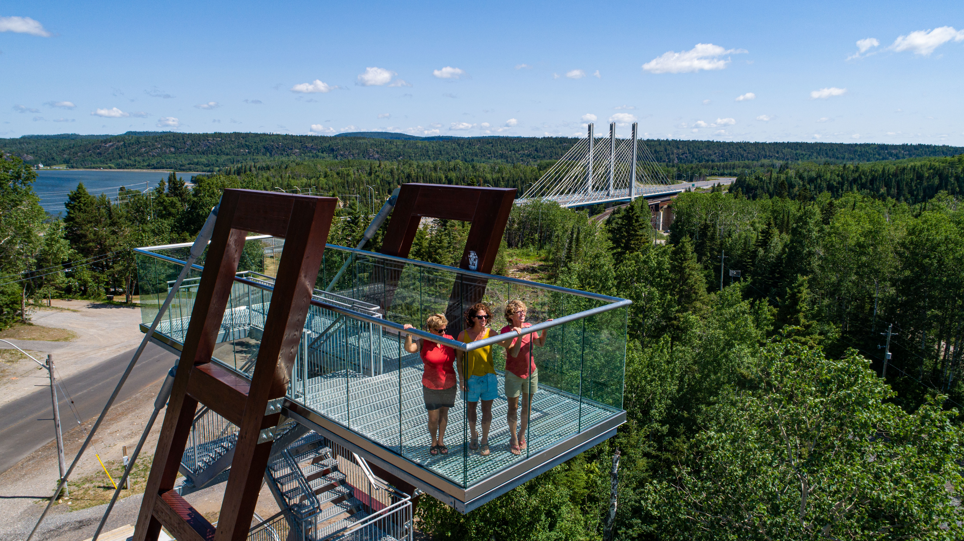
What would they be and why??
If you could pick one MUST visit place
in your community…
-
and one MUST have meal from your community..
Notes:
Project development

Slide 3
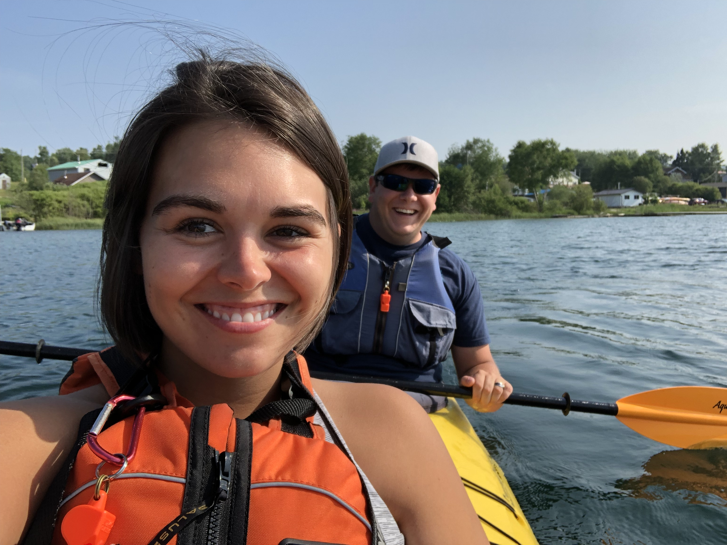
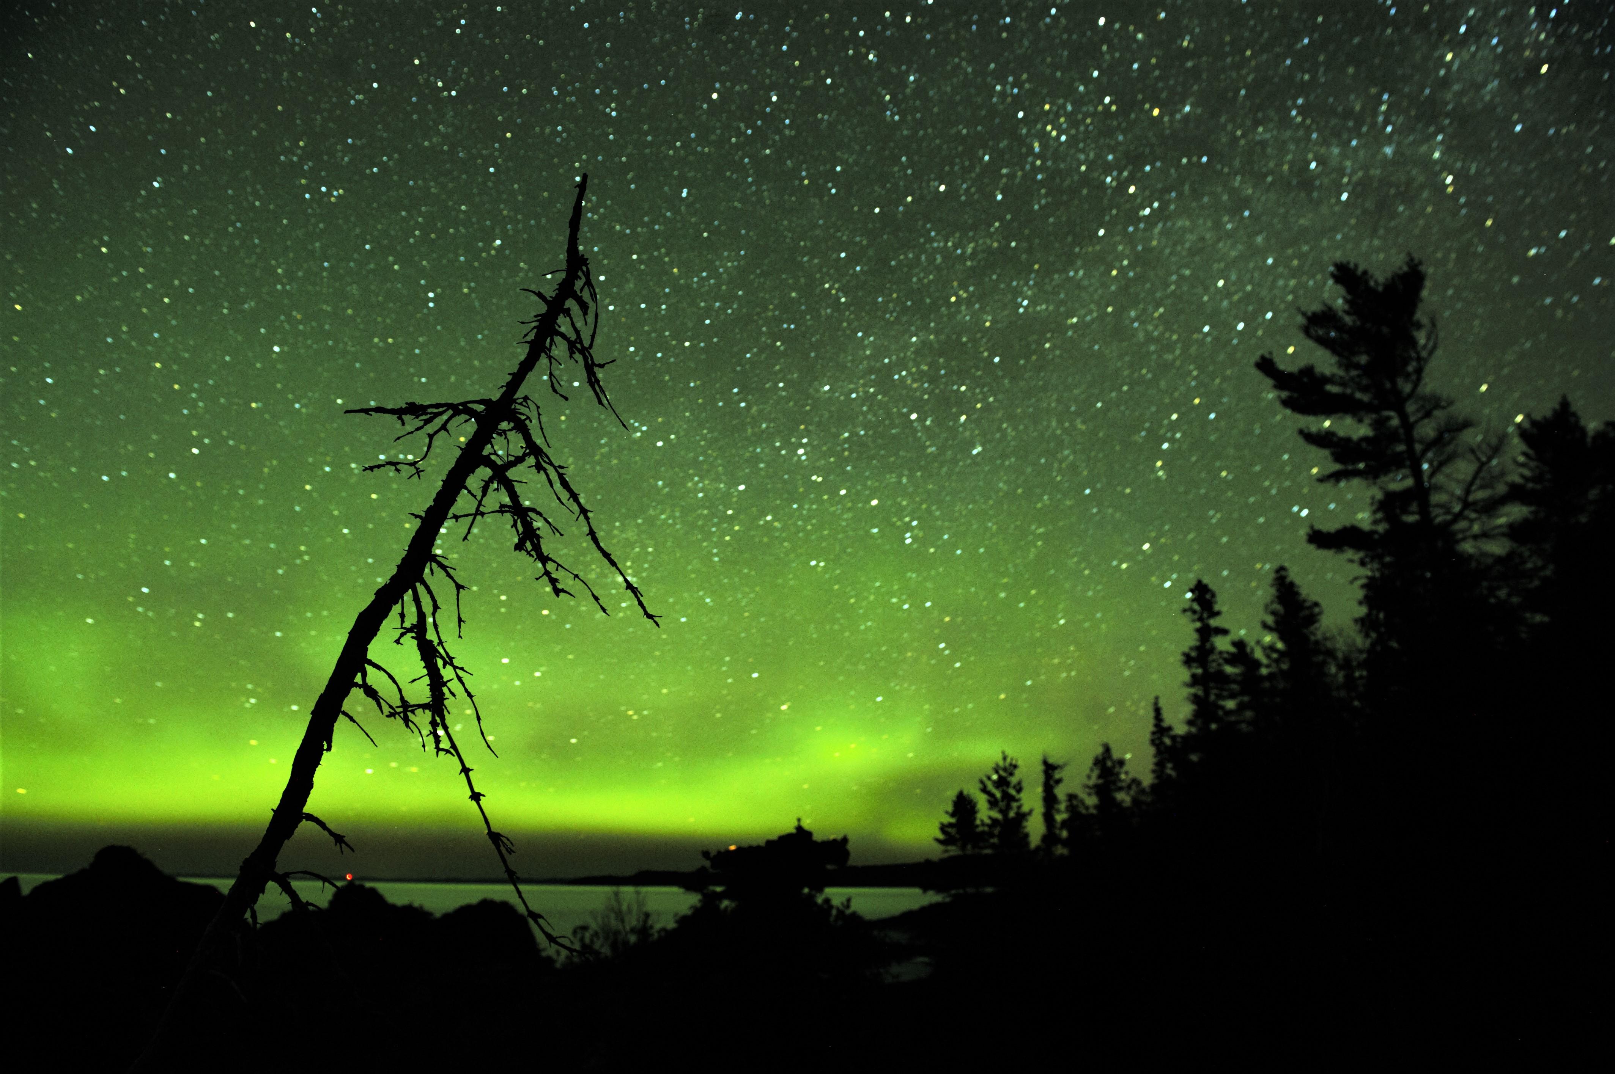
Mission
To build and sustain a world class tourism destination for visitors by marketing the region, fostering relationships with members, and collaborating with partners.

Slide 4
Headquarters
Staff
Tourist Information Centre @ Nipigon
Dan Bevilacqua
Executive Director
Vicki Banning
Executive Assistant
Suzanne Kukko
North Shore Tourism Coordinator
Initiatives
Publications
Websites
Social Media
**Product Development**

Slide 5
How can YOU be the very best at your job?

Slide 6
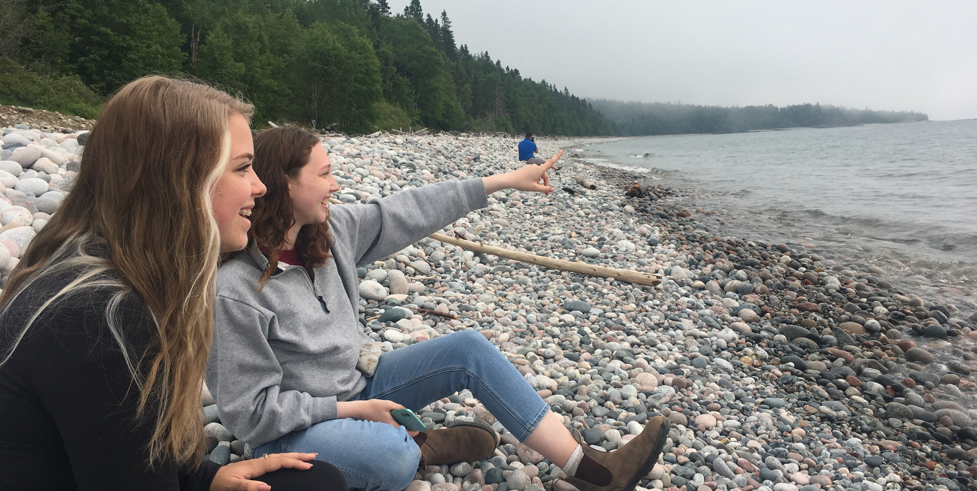
#1: Do one new thing in your region each week!
Take a Hike.
Visit an Attraction.
Eat Local.

Slide 7
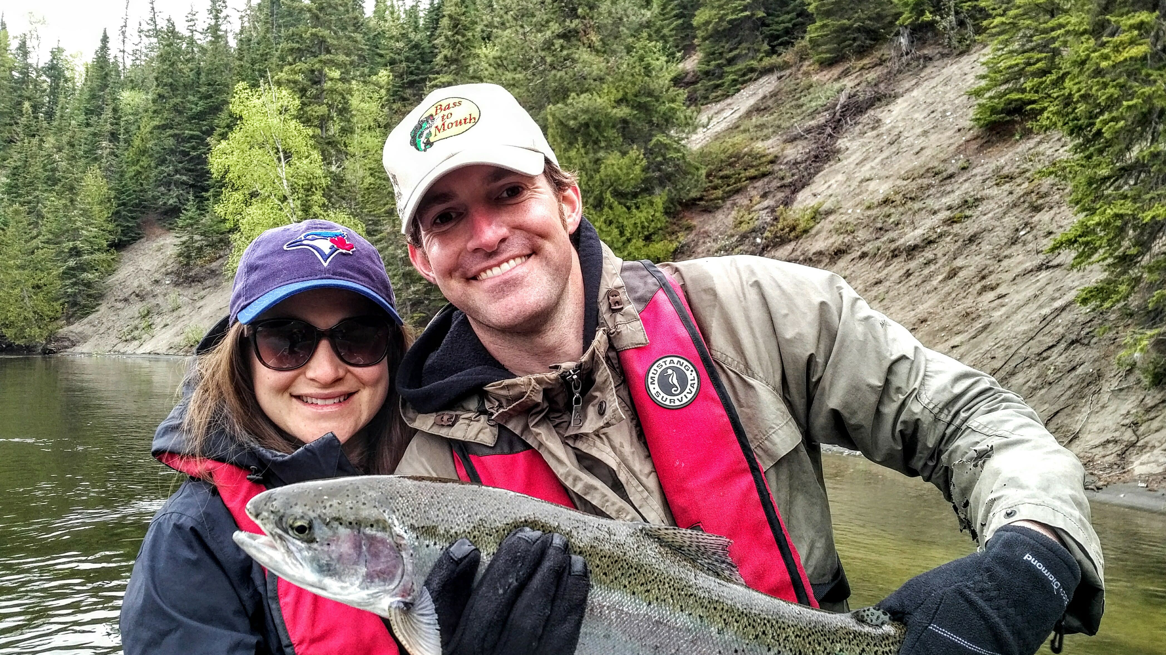
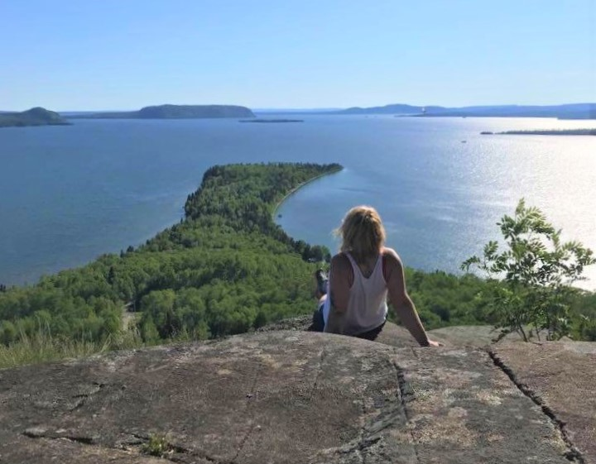
#2 See COVID-19 as an opportunity for tourism.
-
Notes:
Project development

Slide 8
#2 See COVID-19 as an opportunity for tourism.
-lots of wide open space
-many of our activities are naturally social distanced
-local people exploring their own back yard and sharing!
-giving some businesses time to enhance their product
-
Notes:
Project development

Slide 9
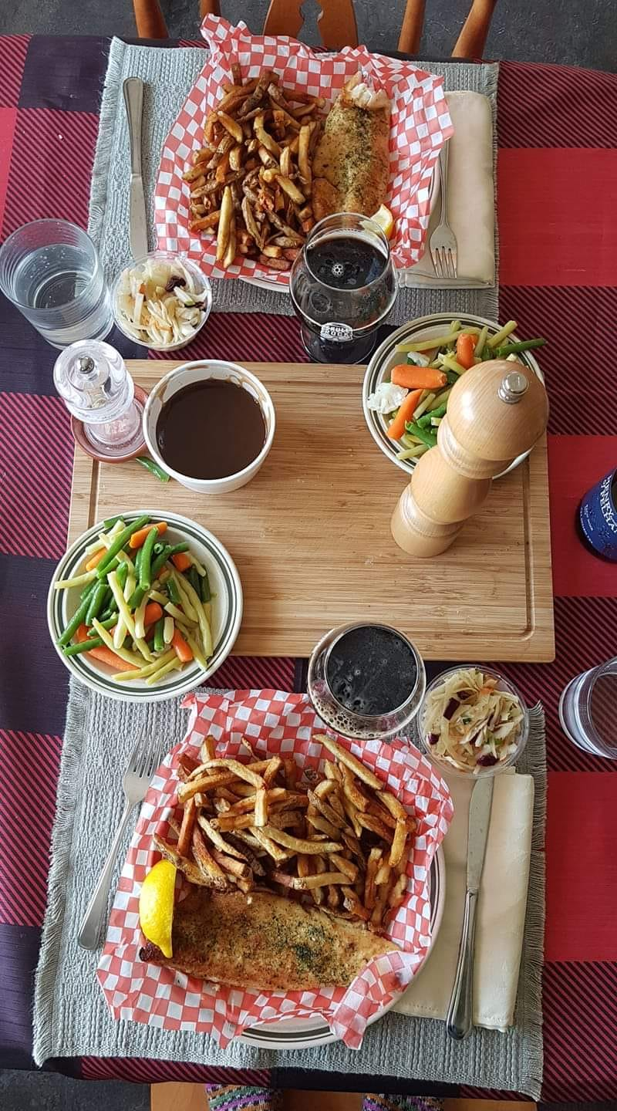
#3 Know your RESOURCES!
www.superiorcountry.ca
www.lakesuperiorcircletour.info
Lake Superior Circle Tour
Adventure Guide
.

Slide 10
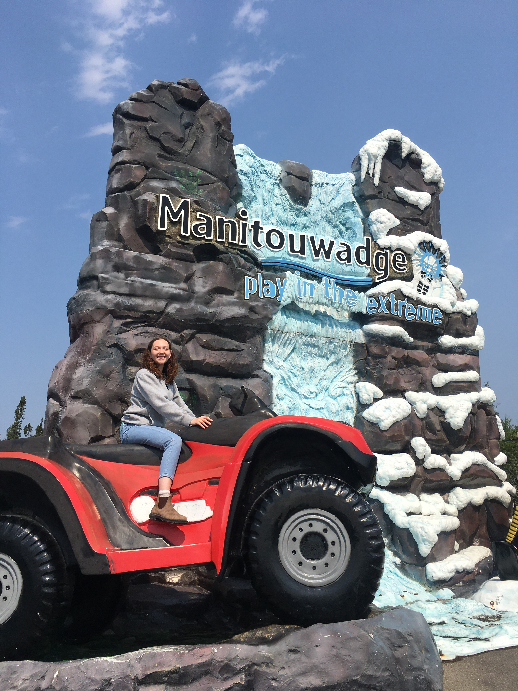
THANK YOU!
Questions?
.

