Slide 1
An Intro to Sunset Country
SEP Student Online Training Session

Slide 2
Welcome
On behalf of the tourism industry in Ontario’s Sunset Country, welcome to your summer job as a travel counsellor. You are the front line ambassadors for the industry and you play a critical role in ensuring a happy visitor experience.
Information is your specialty and learning about your community and its tourism assets is a key part of doing the job.
Here is a little bit about the larger region you are in, much of this will be familiar to you.

Slide 3
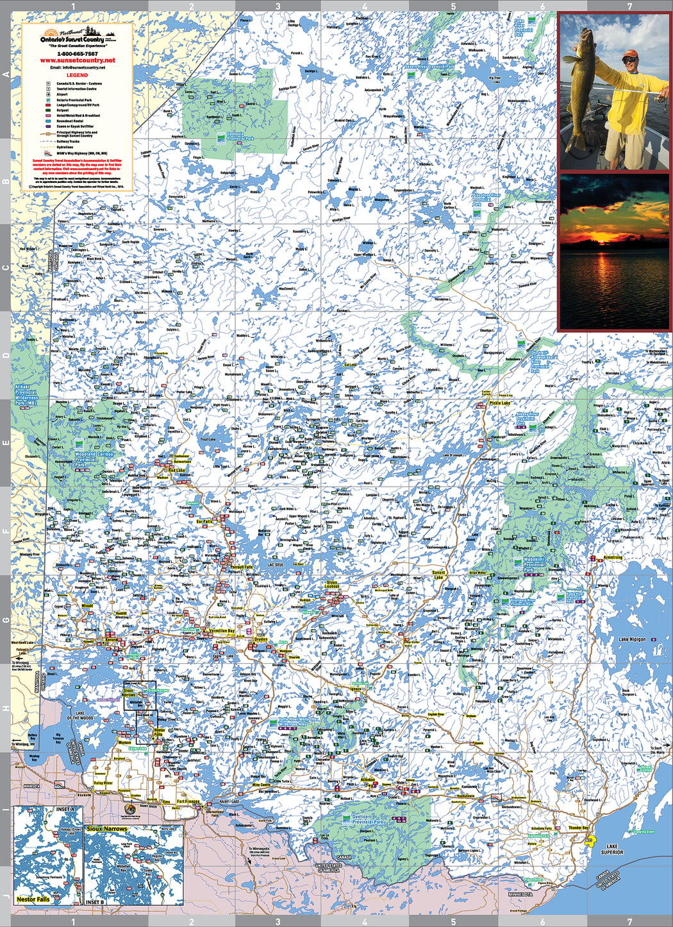
The region covers an area of approximately 100,000 square kilometers
There are 70,000 freshwater lakes in Sunset Country
There is around the same amount of people as there are lakes…
Tourism is one of the largest industries and is largely seasonal, most visitors come in the summer/fall

Slide 4
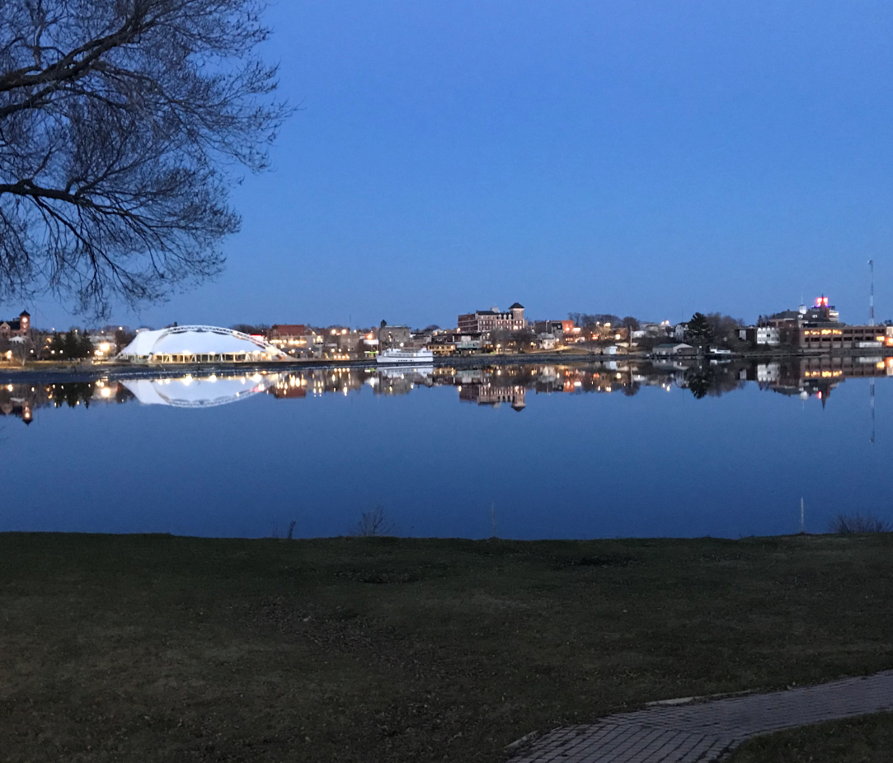
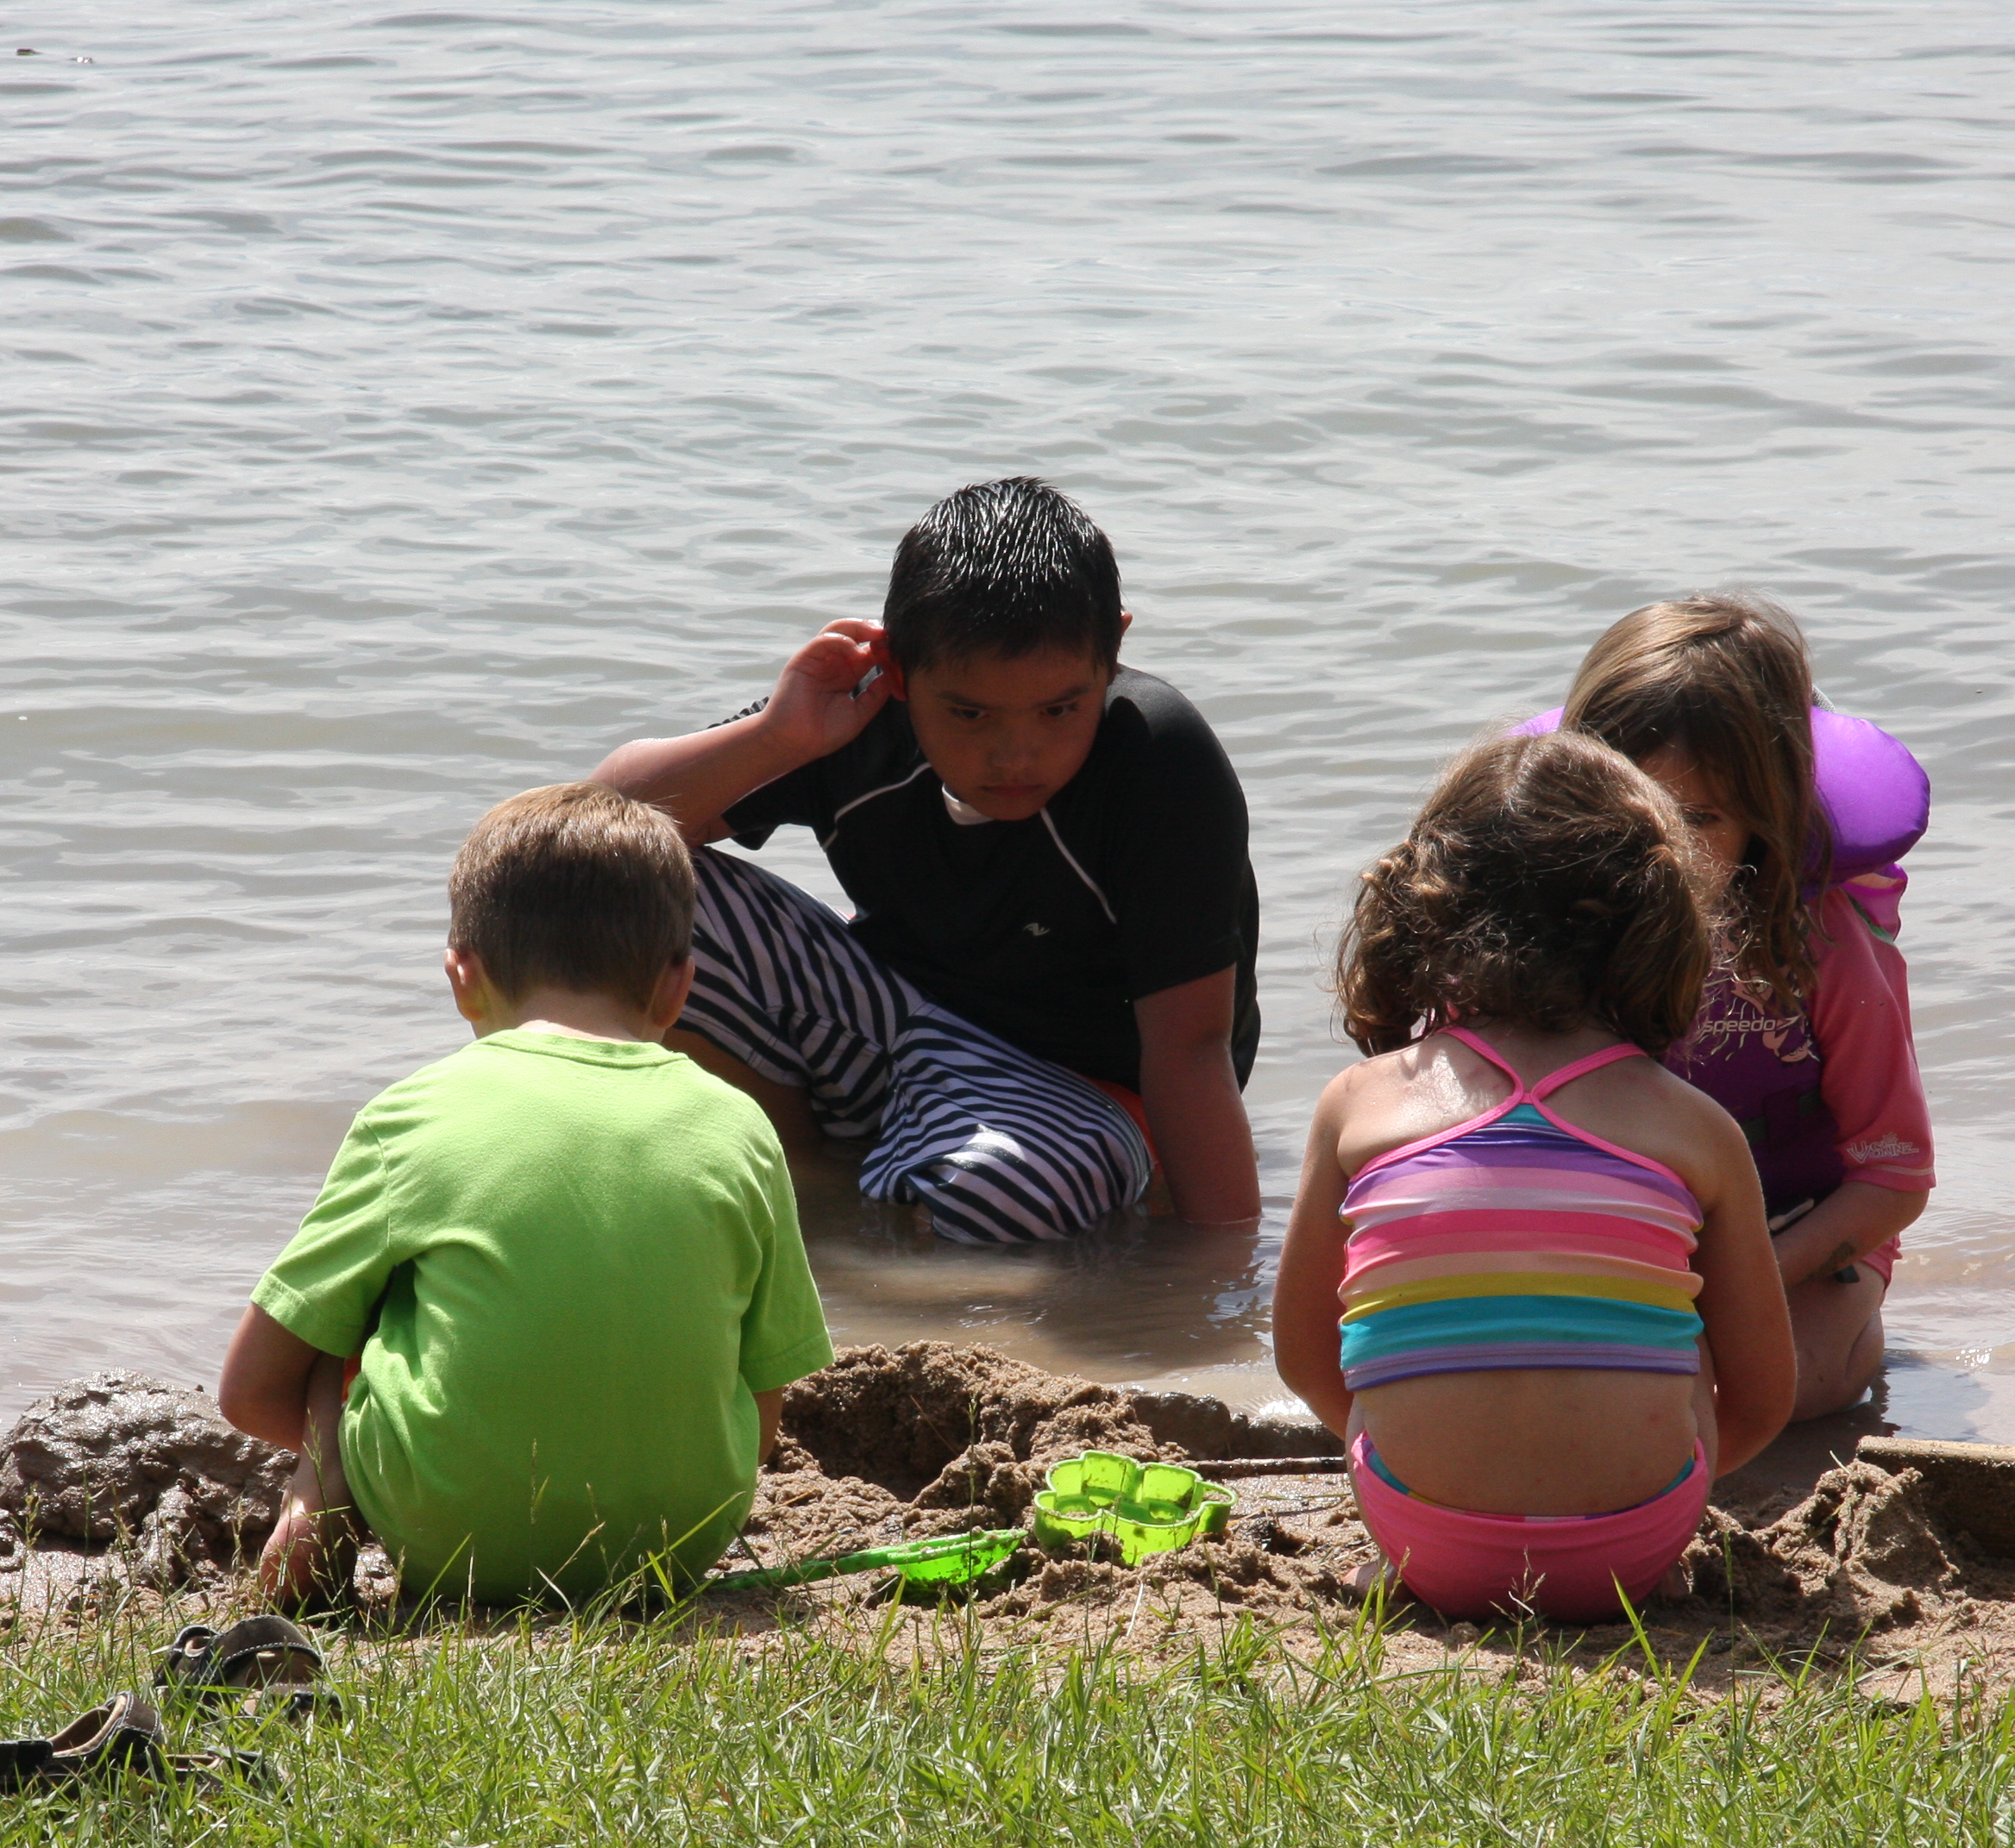
The outdoors anchors the tourism base – almost everything tourism relates to the outdoors
In normal years, events and festivals are important activities but likely not the case in 2021
Fishing is the number one attraction followed by nature/outdoor activities such as camping.

Slide 5
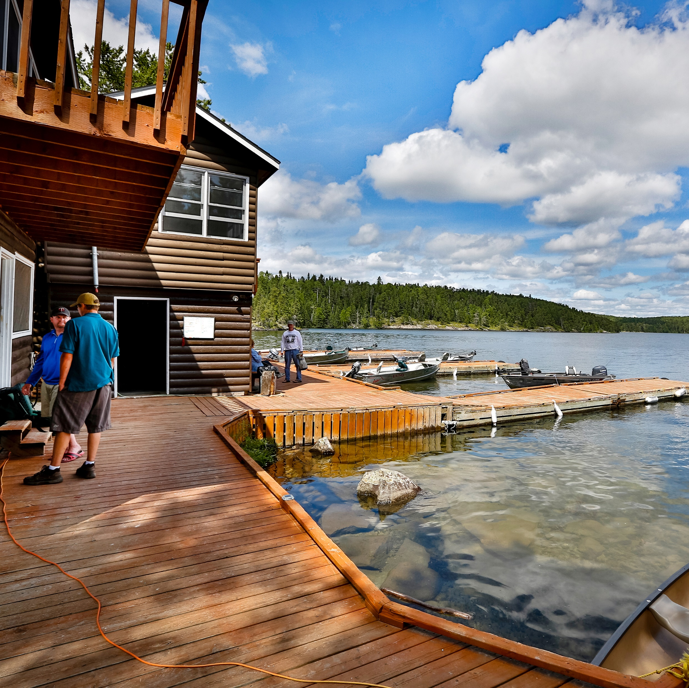
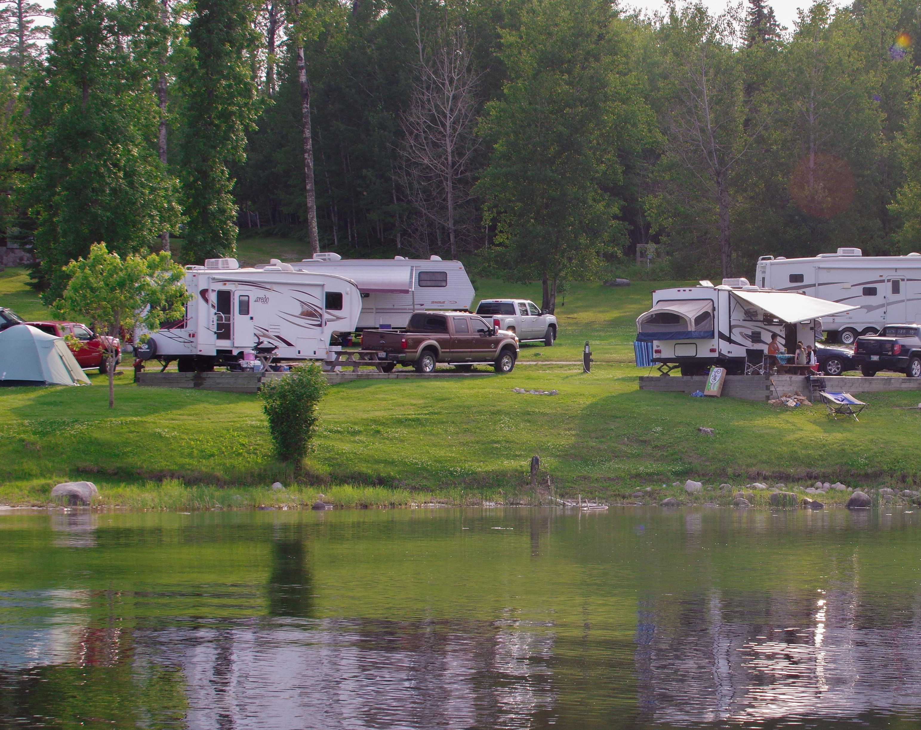
Types of Accommodations Available
One thing you’ll likely be asked is where can we stay overnight, generally, these are people passing through the region.
Resorts & Lodges (cabin rentals)
Hotels and Motels
B&Bs
There are also private campgrounds and provincial parks for the campers.
Resources:
Visitsunsetcountry.com
Ontarioparks.com

Slide 6
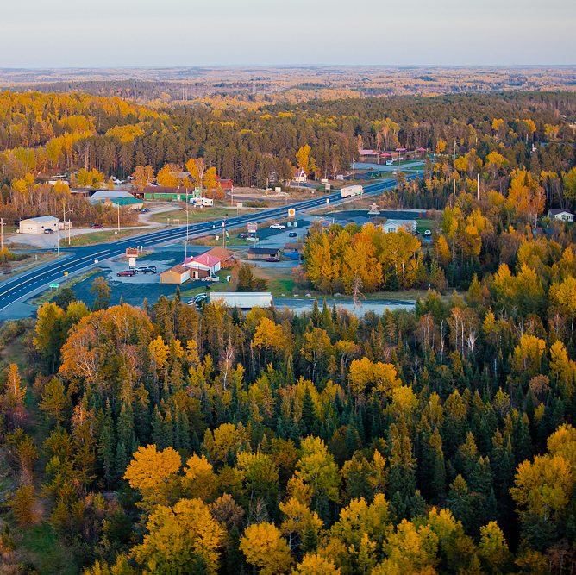
Major Travel Corridors in Sunset Country
You’ll likely be asked for help with directions so it’s good to know the major travel corridors between communities in Sunset Country. Also get to know the routes in the town you work in, the location of local attractions, places to eat, shop, etc.
North/South Corridors
Highway 71 (connects Hwy 11 with Hwy 17 – passes through Sioux Narrows and Nestor Falls)
Highway 105 (goes north off Hwy 17 at Vermilion Bay and through to the Municipality of Red Lake and passes through Perrault Falls and Ear Falls)
Highway 502 (important N/S connector route between Hwy 11 east of Fort Frances and Highway 17 at Dryden – no services!)
Highway 72 (north off Hwy 17 at Dinorwic, going NE towards Sioux Lookout. Also accessible off Highway 599)
Highway 599 (“the Wilderness Corridor”, Ontario’s most northerly all-season road – access off Hwy 17 and it runs through Silver Dollar and north to Pickle Lake)

Slide 7
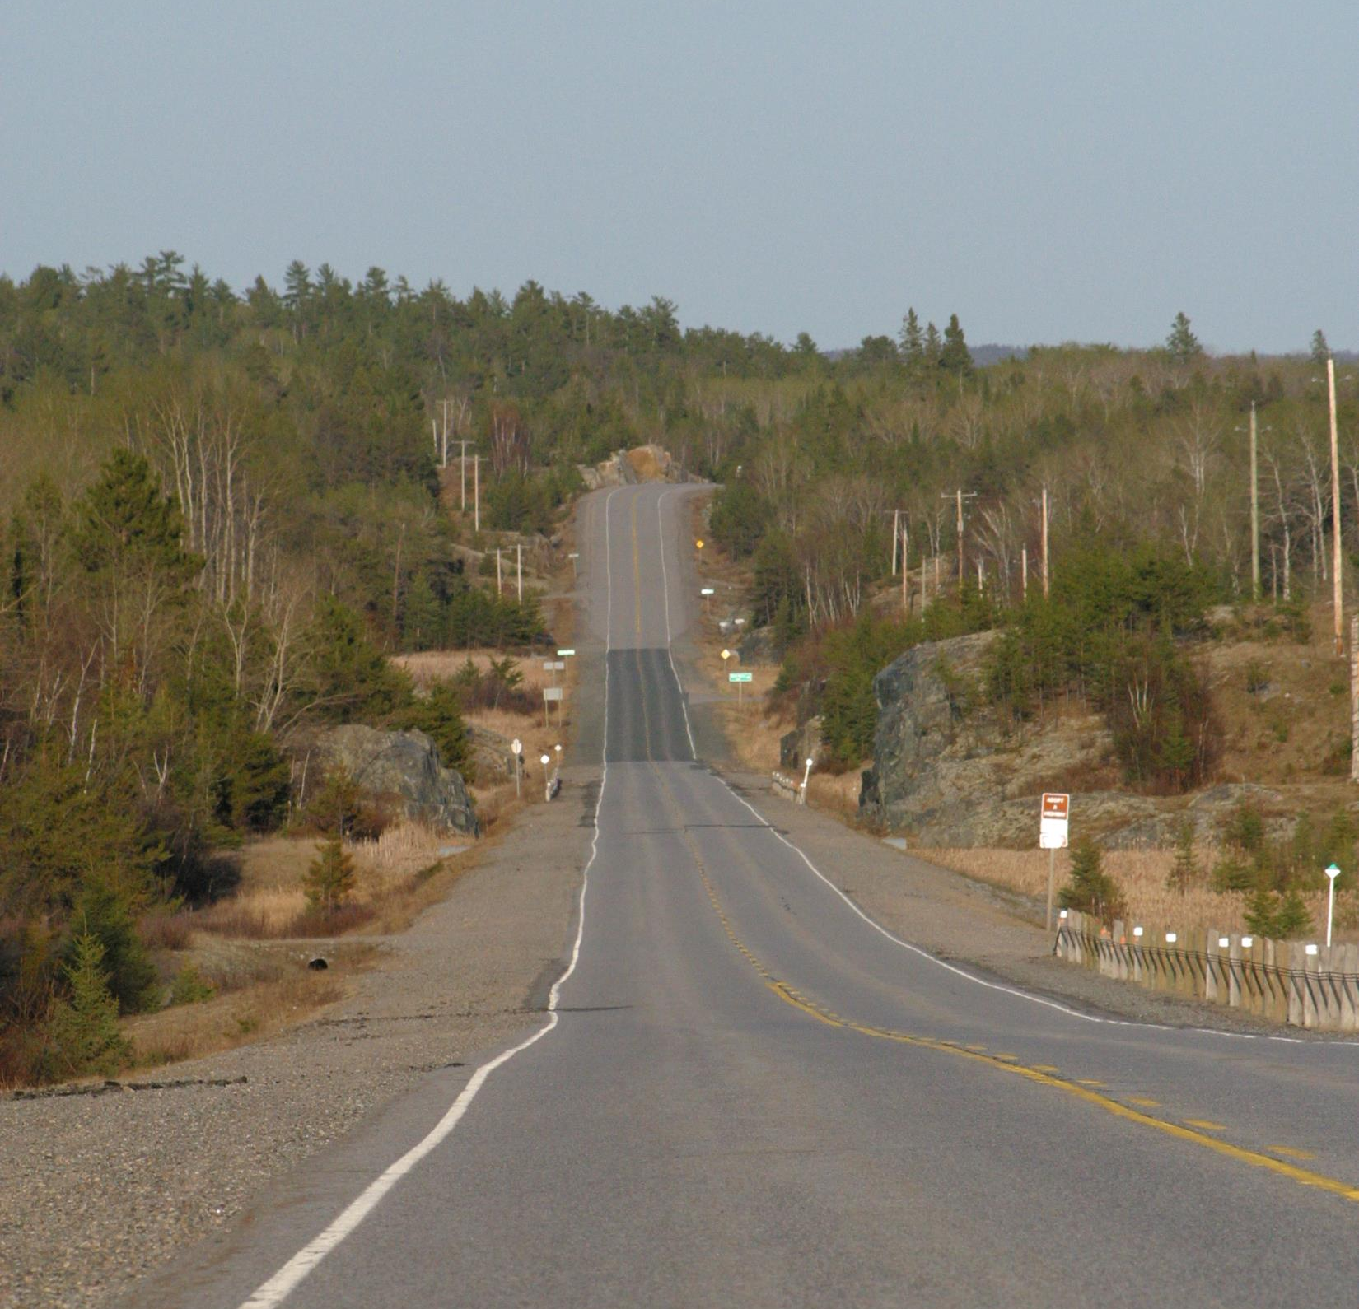
East-West Travel Corridors
Highway 17 – is the Trans-Canada highway and the main commercial traffic route through Sunset Country. It connects with Highway 1 in Manitoba and runs across Ontario. Kenora, V-Bay, Dryden, Dinorwic, and Ignace are all along this route.
Highway 11-17 also known by many as the “King’s Hwy” it runs east-west just north of the Canada-US Border. Less commercial traffic on this route. Runs from Rainy River through Emo, Fort Frances, and Atikokan through and east all the way across Ontario
Other Routes
Highway 621 – off Hwy 11 to Morson
Highway 622 between Atikokan and Hwy 17
Highway 596 off Hwy 17 to Minaki

Slide 8
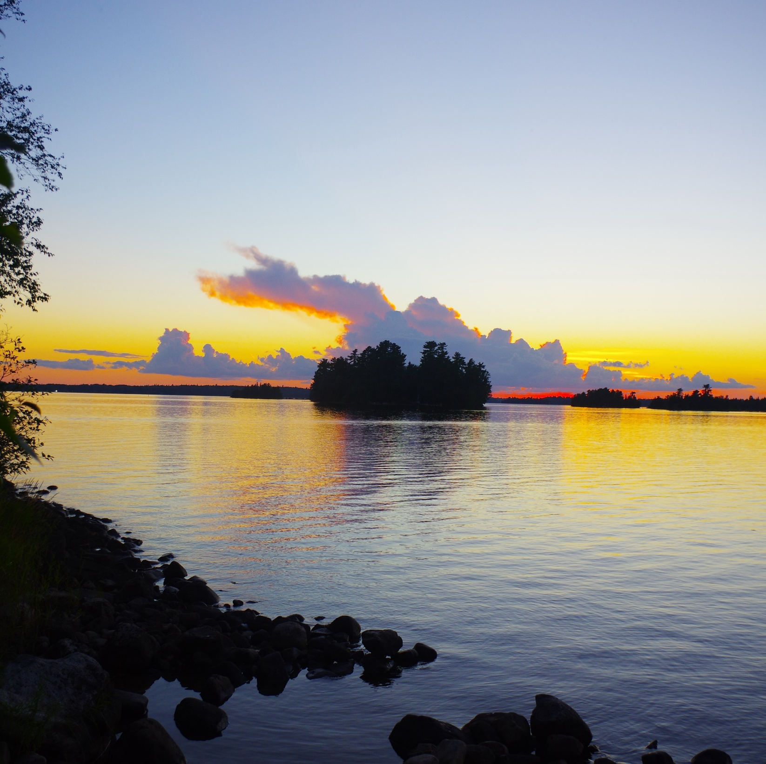
How You Can Help Tourism
Engage with the people who come into the centre and be ready to offer suggestions for them on things to do, places to go, shop and eat.
Use resources available on-line to help them plan activities.
Try to get them to stay longer and visit more in your community/area.
If there are any local events, craft sales, farmer’s markets etc., tell people about them.
Encourage visits to attractions in the area such as museums, Kay-Nah-Chi-Wah-Nung Historical Centre etc.
Be a tourism ambassador as you are the front line for tourism in the region and are likely the first “local” these visitors will speak to – make them feel welcome and simply, try to help them as much as possible.
Good luck to all of you!
I’m here to help, so give me a call, Gerry Cariou, 1-800-665-7567

