Slide 1



Travel Information Centre Summer 2021 Training – Northeastern Ontario
July,2021
Notes:
Change Logo to 2021

Slide 2


Program Outline
Working Differently
  Helping the guest plan during a changing landscape
  Different needs during a pandemic
  COVID impact on the visitor
Service delivery – different approaches
Algoma Country product knowledge
Dealing with uncertainty
Dealing with stress – yours and the traveller
Dealing with difficult situations
Collecting information

Slide 3


Eva Gutsche
STEM Consulting
Notes:
Having been working with several provinces with post COVID-19 recovery. A new way of working for all of us as we learn to operate during a global pandemic. Certain aspects of our life have change drastically.
In addition to these current Eva is an EQ Trainer for DC and works across Canada with private and public sector assisting businesses in maximizing their performance through enhanced selling and communication skills, leadership development and strategy and innovation.

Slide 4


Trevor Beard
Executive Director of Northeastern Ontario Tourism (NeONT)

Slide 5



Your name
What Travel Information Centre you work at?
How long have your worked with the TIC?

Slide 6

Take Aways
Deck will be available after the workshop
As we go through the webinar consider what you will need to do differently from a TIC service delivery standpoint based on the impact of COVID-19

Slide 7

SECTION 01
SECTION ONE
Working Differently
Anticipated business levels

Slide 8
SECTION 01
Consider the needs of the guest during COVID-19
Fill product gaps
Help the guest plan their route and reconfirm availability
Relieve their concerns
Customize the experience to meet the guest’s needs during the pandemic
Enhance the guest experience by taking a personalized approach to help them
Create great memories
Customer Interactions & COVID-19

Slide 9

SECTION 01
State of Emergency extended until July 15 (proposed)
Self-isolating for 14 days after all international and US travel
US border closed
Focus on local, provincial travel
Heightened cleaning and hygiene practices and guidelines
Increased protection for seniors
Group size restrictions
Physical distancing – 2 meters
Mask rules changing quickly (municipal guidelines)
Current Situation for Ontario Residents

Slide 10

SECTION 01
Current Challenges in Suggesting Travel Experiences
Group size restrictions
Food & Beverage options vary and are more limited
Operating status and opening and hours of sites, attractions & experiences
Health and safety concerns
Some confusion and uncertainty about changing rules and guidelines

Slide 11



SECTION 01
Engaging with the Visitor
Traditional – walk-in with safety measures
Hours of operation may vary
Could be via phone or on-line
Things will likely be different

Slide 12

SECTION 01
Support Local Tourism
Messaging
National
Provincial
Regional
Private
Retired CBC news anchor Peter Mansbridge calls on Canadians to travel the country this summer to support the struggling local businesses and the tourism industry. Tourism employs 1 in 10 Canadians and Canadians spent $36 billion on international tourism last year. Peter invites Canadians to imagine the influence just half of that could have on the small businesses around Canada.
https://ca-na-da.com/mansbridge
July 2, 2020

Slide 13
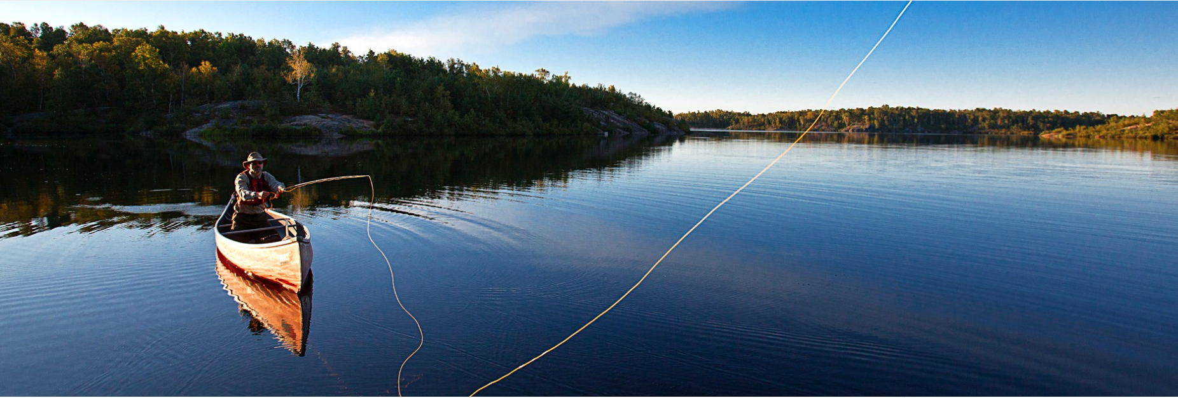
SECTION 01
Inspire Local – Locals First

Slide 14
Recap
SECTION 01
Working Differently
Things will be different
Traveller have new needs and new concerns
Your input is vital – on the ground intel
Engagement might be different
Change is ongoing
Notes:
How do we form a strong positive attitude?

Slide 15

SECTION 02
SECTION TWO
Service Delivery & Guest Interaction
Anticipated business levels

Slide 16

SECTION 02
Call to action
How long does it take to make a first impression?
3 seconds
10 seconds
30 seconds
One minute

Slide 17

SECTION 02
First Impression
How long does it take?
About 3 seconds

Slide 18

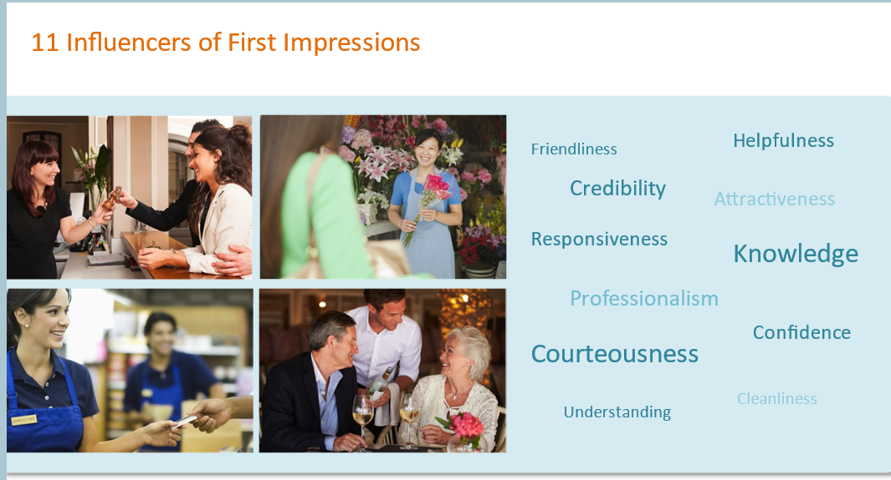
First Impressions
SECTION 02
From OTEC online TIC program

Slide 19
First Impressions – In person
SECTION 02
55% = appearance
38% = tone
7% = words

Slide 20
First Impressions – On the phone
SECTION 02
80% = tone
20% = words

Slide 21

Call to action
Participant Poll: Service Qualities
What do you feel will be the most important and appreciated customer service qualities, to showcase this summer?
Patience
Flexibility
Relationship Building
Empathy
Destination Knowledge
Adaptability

Slide 22
SECTION 02
Attributes & Qualities
Patience
Kindness
A Sense of Humour
Empathy
Flexibility
Adaptability
Approachability
Relationship Building Skills
Creativity
Resourcefulness
Listening Skills
Increased Knowledge
Ability to Diffuse a Situation

Slide 23
SECTION 02
Consider what comes Easiest to you – feel free to share in the Chat Box
Kindness
A Sense of Humour
Patience
Empathy
Flexibility
Adaptability
Approachability
Relationship Building Skills
Resourcefulness
Creativity
Ability to Diffuse a Situation
Destination Knowledge
Listening Skills

Slide 24
SECTION 02
Consider what comes you would like to improve upon – feel free to share in the Chat Box
Kindness
A Sense of Humour
Patience
Empathy
Flexibility
Adaptability
Approachability
Relationship Building Skills
Resourcefulness
Creativity
Ability to Diffuse a Situation
Destination Knowledge
Listening Skills

Slide 25

SECTION 02
Building new strengths
Acknowledge which quality you wish to desire
Understand why this is a benefit
Understand the challenges of not improving this quality or skill
Create a development plan
Engage support

Slide 26
SECTION 02
One thing your will work on
Based on the exercise identify one thing you will work on this summer

Slide 27
SECTION 02
What is a dominant, overall, major influencer in your life which impacts all interactions?

Slide 28

Positive Attitude

Slide 29

Positive Attitude
“Attitude.....fuels my fire or assaults my hope. When my attitude’s right, there’s no barrier too high, no valley too deep, no dream too extreme, no challenge too great for me.” Charles Swindoll
Notes:
How do we form a strong positive attitude?

Slide 30
SECTION 02
Connecting with the Traveller
01
Ask
Inquire into the overall travel experience
Ask open-ended questions
Plan your questions in advance – what do you need to know in order to guide and help the customer?

Slide 31
SECTION 01
SECTION 02
Seek to truly understand – get the whole picture
Delve deeper
Uncover overt and hidden needs
Really understand the guest’s wants, needs AND concerns
02
Understand
Uncover concerns and perceived challenges

Slide 32
SECTION 02
RECAP
Connecting with the Traveller
Stay on top of news and changes (as much as you can)
Provide your knowledge and expertise
Guide the traveller based on what you have learned about them
03
Deliver
Provide knowledge & expertise

Slide 33
SECTION 02
RECAP
Connecting with the Traveller
Ask, Understand, Deliver
01
Ask
Inquire into the overall travel experience
02
Understand
Uncover concerns and perceived challenges
03
Deliver
Provide knowledge & expertise

Slide 34
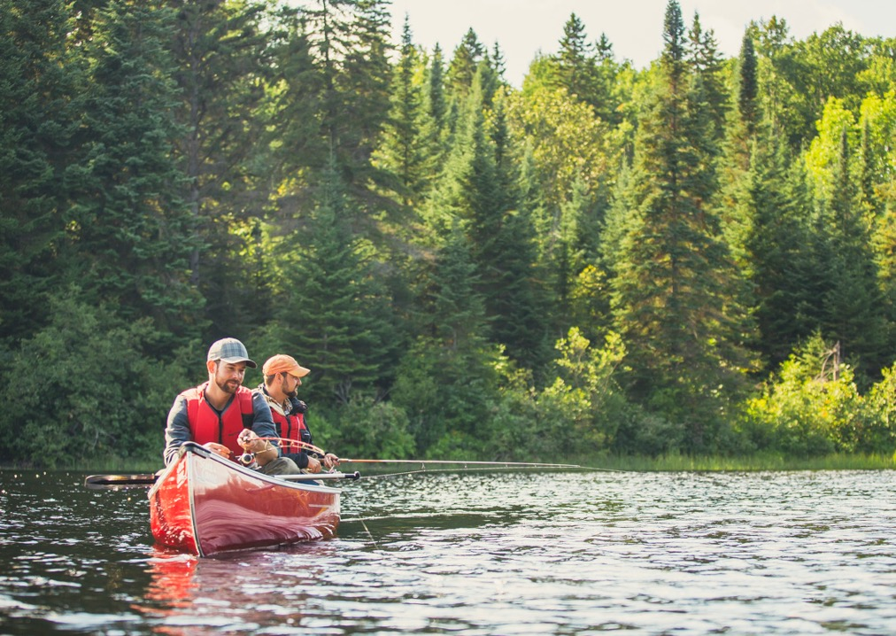
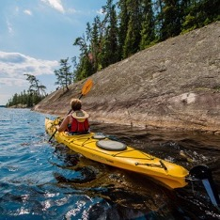
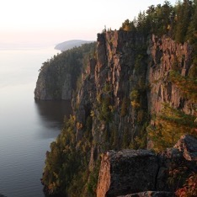
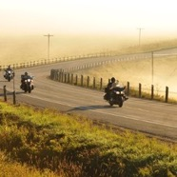



Northeastern Ontario Tourism
is a not for profit partnership based organization. Our mandate is to market our partners and our region over all. A region that is 184,000 km² / 71,000 miles²

Slide 35
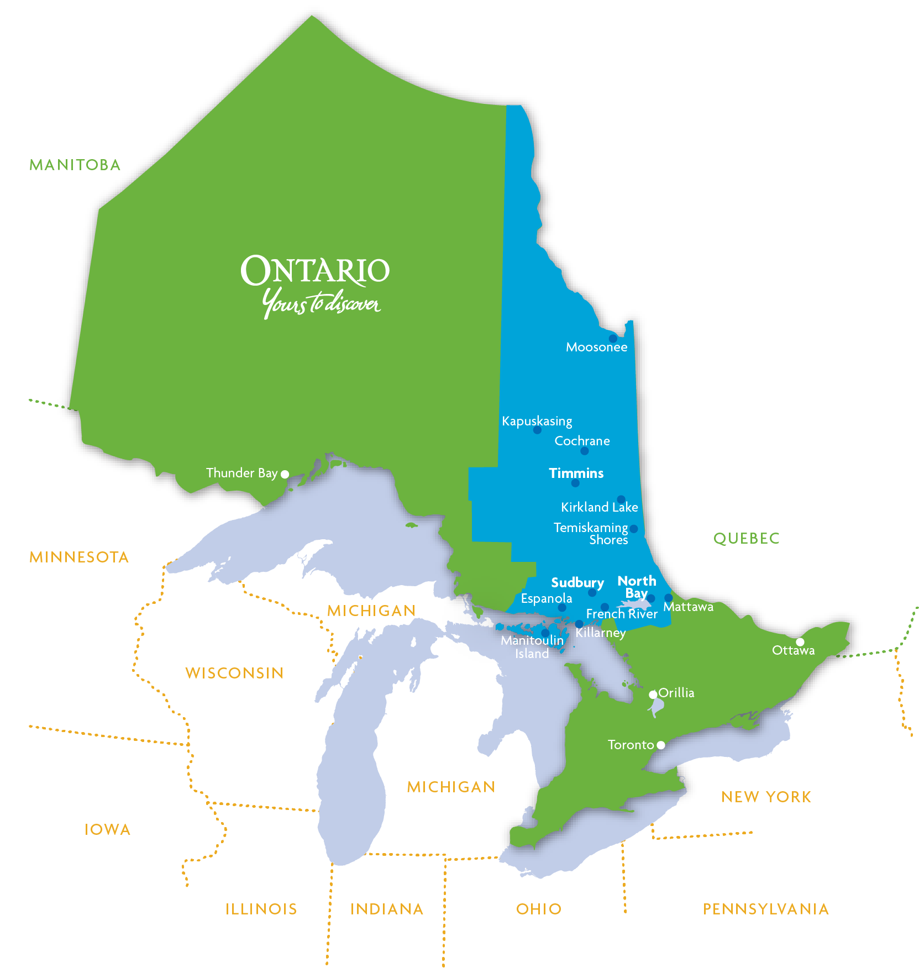
Getting Here.
Our region is easily accessible by various modes of transportation. Highway 400/69 and Highway 11 connect the region with Southern Ontario and Trans-Canada Highway 17 provides an East/West corridor, meaning the region is less than four hours from Toronto, Ottawa. Connecting highways also make for easy access to drive in from the Northern United States!
Multiple bus lines offer service to major destinations throughout the region, as well as guided bus tours. Air and rail travel are other popular options. No matter how you get here, there will always be a way!
How
To Travel
From Toronto:
Sudbury - 1 hr 9 min
Timmins - 1 hr 22 min
From Toronto:
Sudbury - 388 km/241 mi
North Bay - 345 km/214 mi
Timmins - 705 km/437 mi

Slide 36
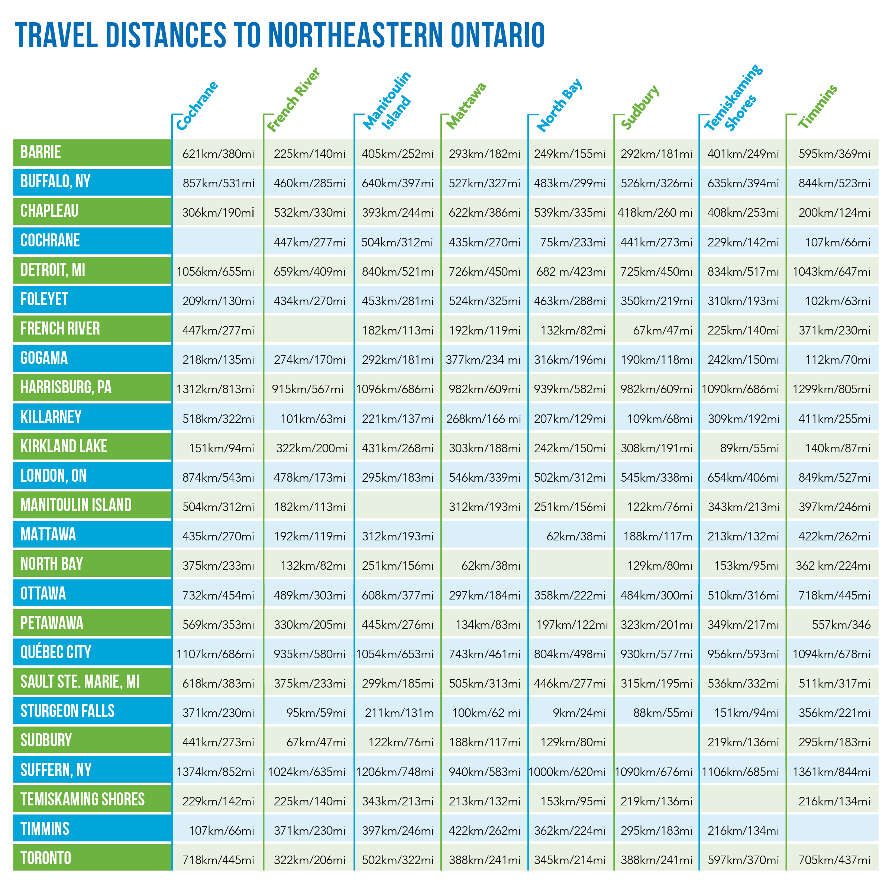

Slide 37
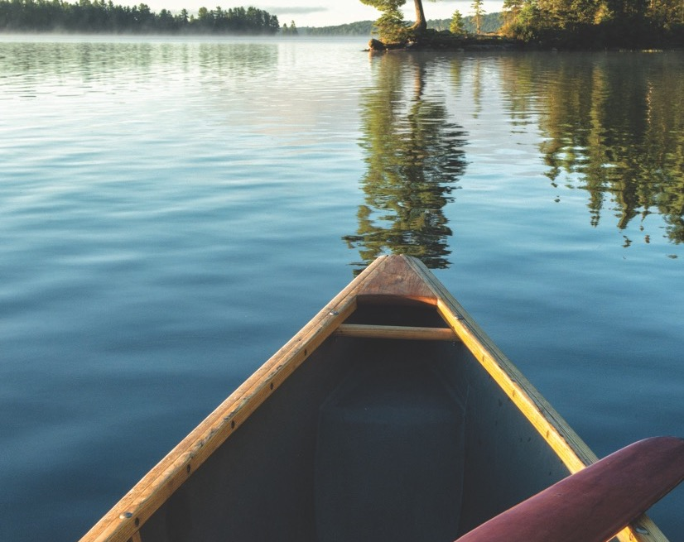
Exploring The Northeast:
Home to world-class paddling, hiking, cycling, skiing, snowshoeing, snowmobiling and even flightseeing. We have thousands of kilometers of paved roads winding through a pristine wilderness for epic road trips by car, RV, or motorcycle and countless trails on crown land and backcountry roads for off-road adventures. Our welcoming communities offer urban shopping, innovative restaurants, and hometown markets each with their own specialties plus amazing family attractions like Sudbury’s Science North and the Canadian Polar Bear Habitat in Cochrane.

Slide 38
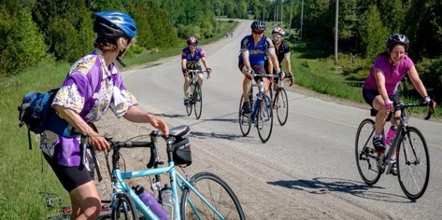
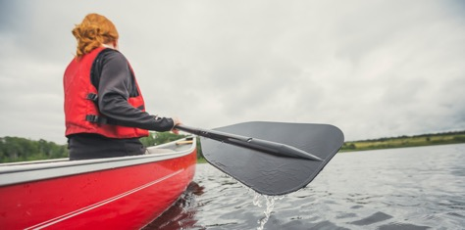
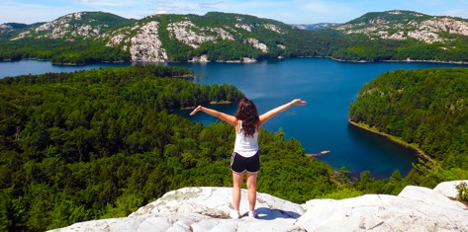
Exploring the
Northeast:
FUN FACTS
The highest elevation in Ontario is the Ishpatina Ridge, 90km north of Sudbury
Home of the Canadian Polar Bear Habitat where you can get close to 3 bears
Largest freshwater island in the world - “Manitoulin Island”
Largest game preserve in the world (7,000 square km/3,000 square miles)
Once home to internationally renown conservationist “Grey Owl”
Home of Hockey Hall of Famer, Tim Horton, who started the coffee chain
Hometown of musician Shania Twain is Timmins
We have “White Moose” known as the Ghost or Spirit Moose
Oldest Anglican church in North America
The sport of “Ringette” was invented in North Bay
The top of our province and our region is where the “Hudson’s Bay Company” started
Large Indigenous population
We have NORTHERN LIGHTS
50 + species of fish
Fishing happens ALL year round

Slide 39
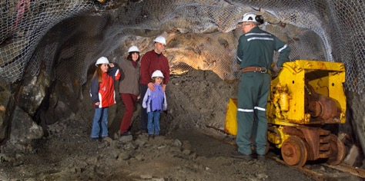
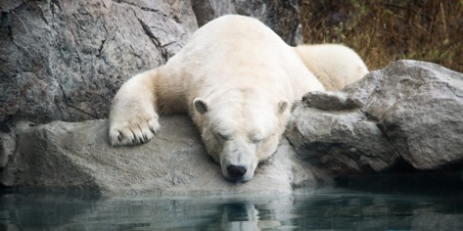
Exploring the
Northeast:
THINGS TO DO
Summer
Fishing
Fly Fishing
Hiking
Paddling
Camping
Glamping, Yurts
Boating
ATV’ing
Motorcycling
Winter
Snowmobile
Skiing/Snowboarding
Ice Fishing
Hiking
Snowshoeing
Learn about Indigenous culture at one of the many Pow Wow’s
See the works of art of the “Group of Seven” painters
Enjoy our many attractions, boat tours, and festivals (COVID-19 pending)
Enjoy our beaches
Enjoy a few of the thousands of lakes and rivers

Slide 40
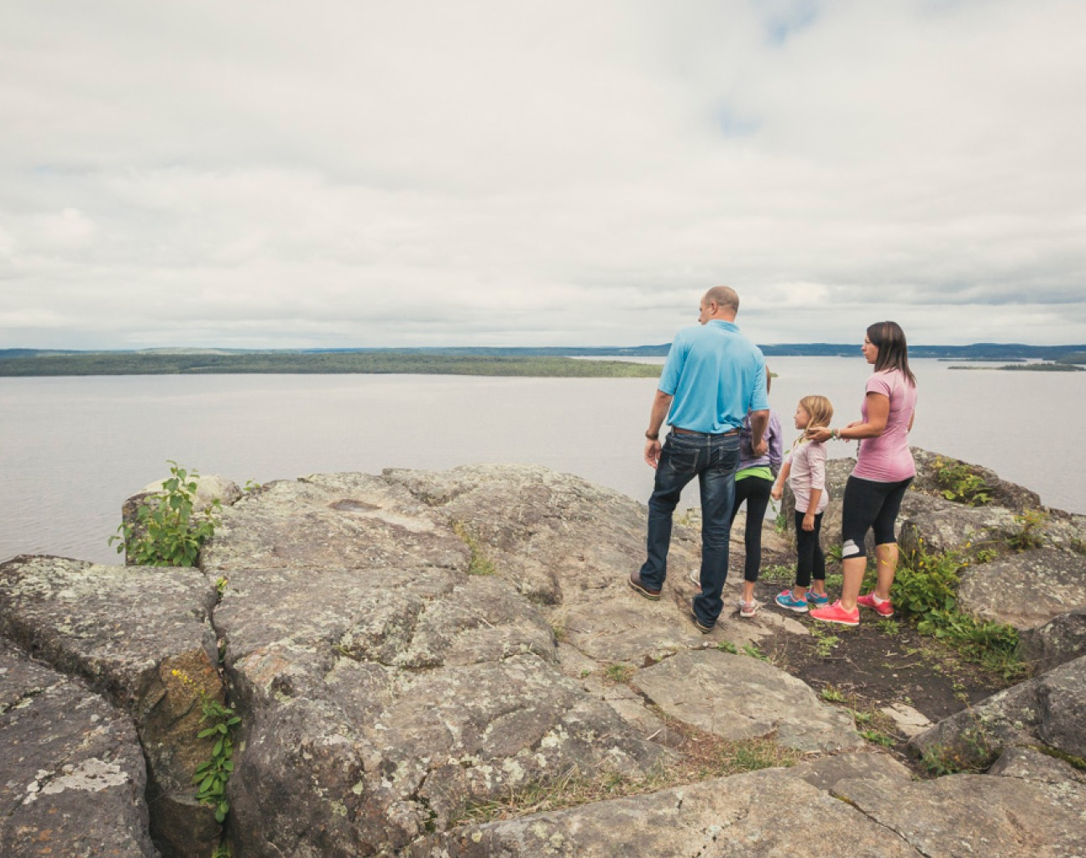
Resources:
www.northeasternontario.com
  searches can be done by community or activity within the
  drop down menus
  or type something into the search window at the top right corner
Digital Downloads
  Travel Guide
  RV/Motorcycle Touring Map
  Museum Touring Map

Slide 41
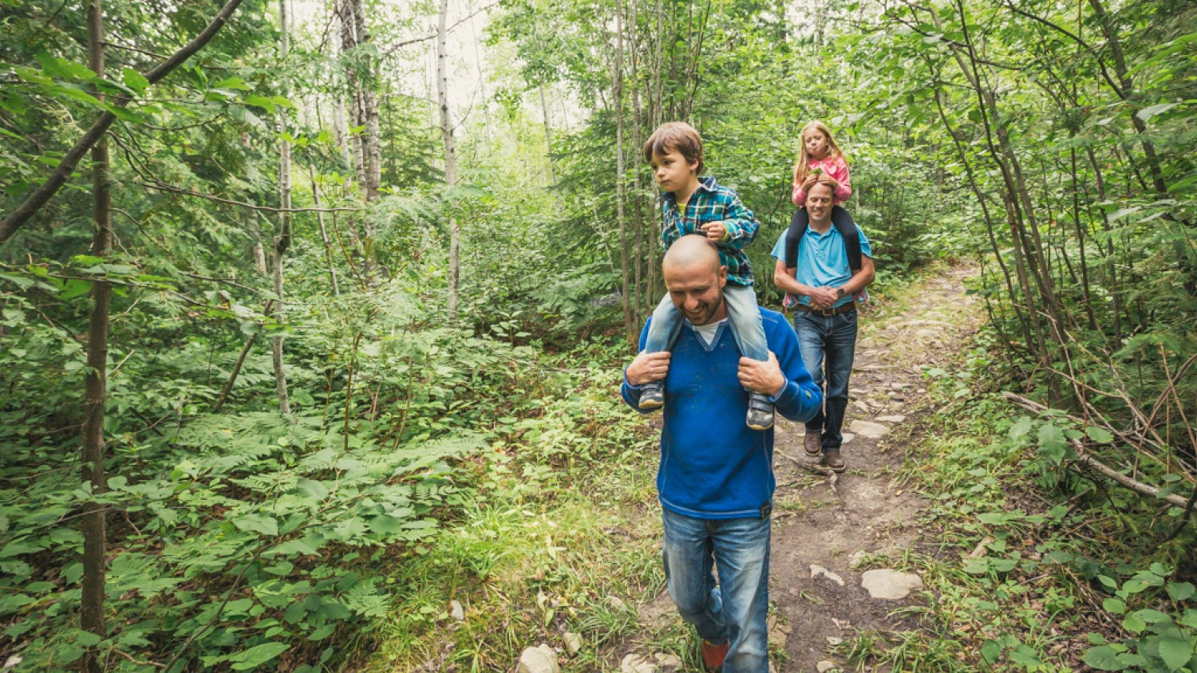
ALL OF OUR OUTDOOR SPACES ARE OPEN!

Slide 42
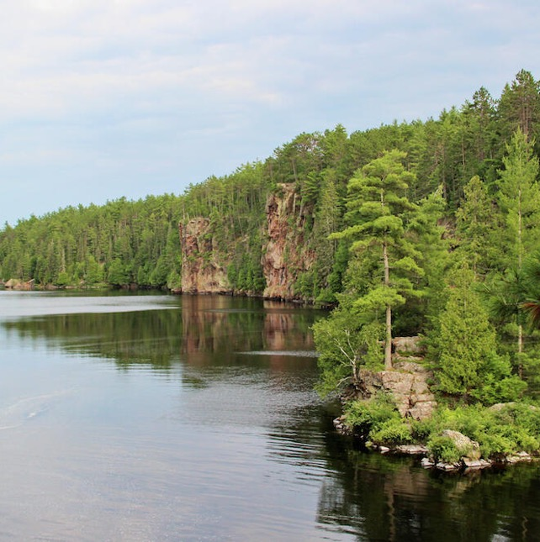
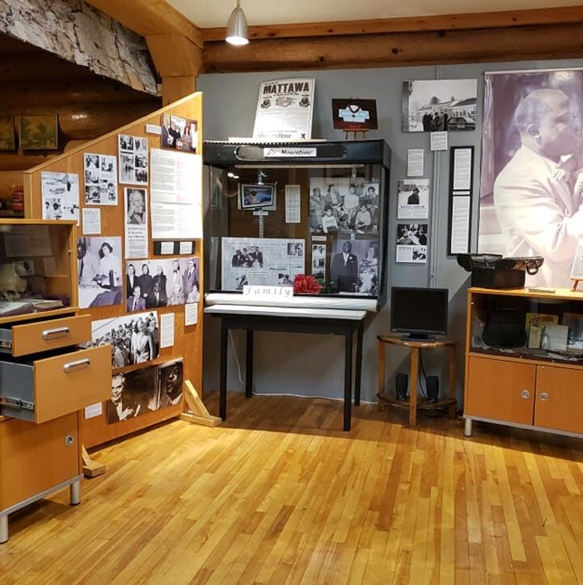
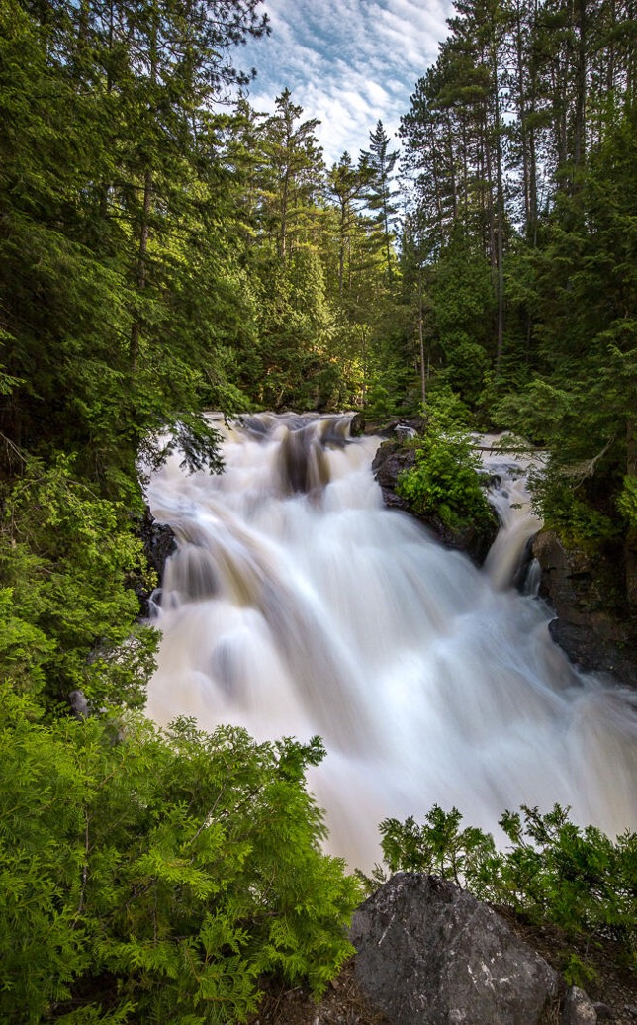
Papineau-Cameron
Mattawa
Voyageur Multi-Use trail System (VMUTS) offers a year round haven for outdoor enthusiasts!
Hike the Eau Claire Gorge or the Brent Crater Trail
Cycle on the Voyageur Cycling Route- 654 Km connection 29 communities from Ottawa to Sudbury
Fish the Mattawa River or Ottawa River
www.papineaucameron.ca www.mattawa.ca

Slide 43
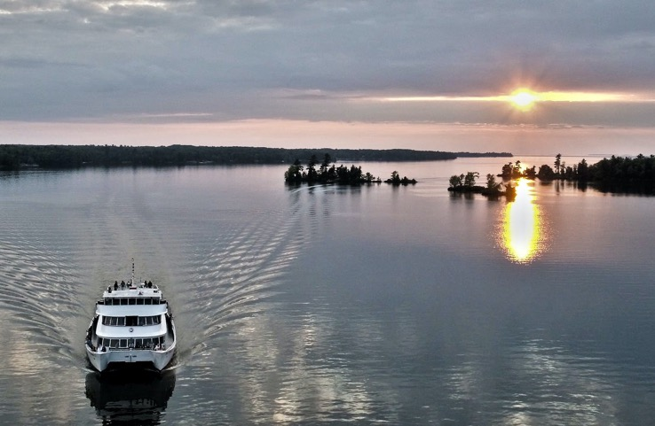
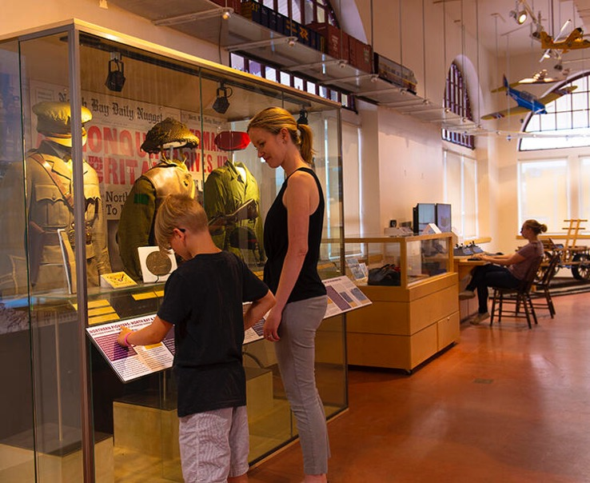
North Bay
Chief Commanda II running as of July 1
WKP Kennedy Gallery is taking appointments for in-person viewing
Farmer’s Market (Wed & Sat)
Many Patio’s, 2 Breweries
All trails OPEN
Temporarily closed
Canadian Forces Museum of Aerospace Defence
Capitol Centre (Stage 3)
Most Galleries
Heritage Railway & Carousel
North Bay Museum (Opening Stage 3)
ENCOURAGE VISITORS TO CALL AHEAD
www.tourismnorthbay.com

Slide 44
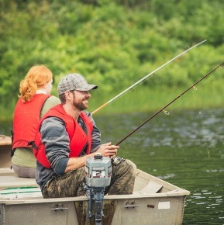
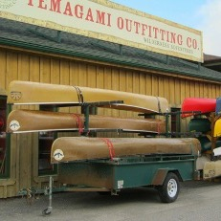

Temagami
(Ojibwe for “deep water”)
Former home of conservationist/paddler Grey Owl (Archie Belaney)-1906 to 1910
Climb the Temagami Tower for the best view of the region
Rent a Houseboat
Fish
Take a ride on a float plane and see the sights!
Go back country camping
www.temagami.ca

Slide 45
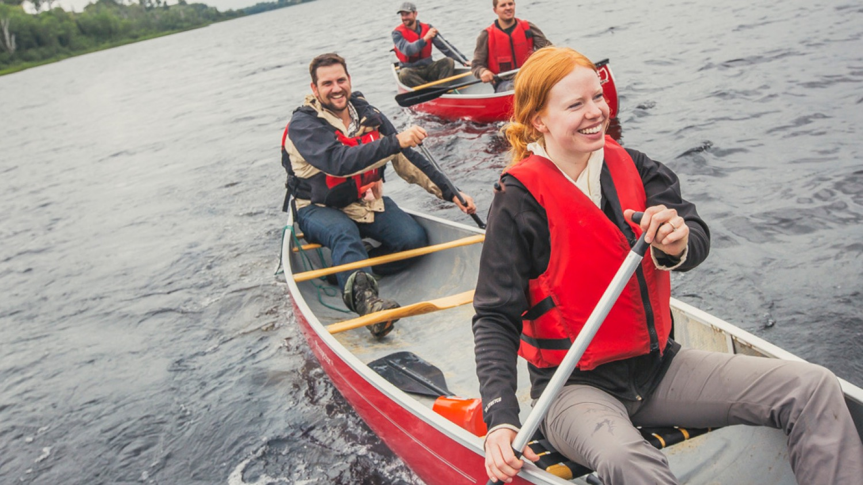

Slide 46
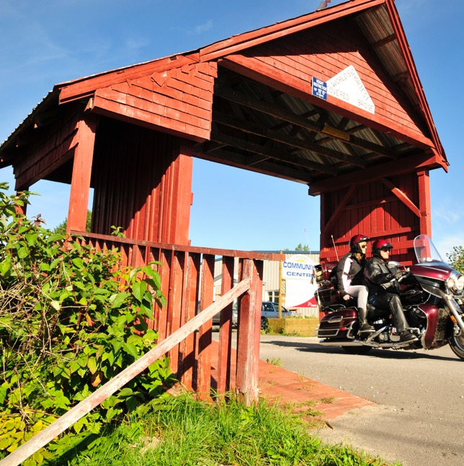
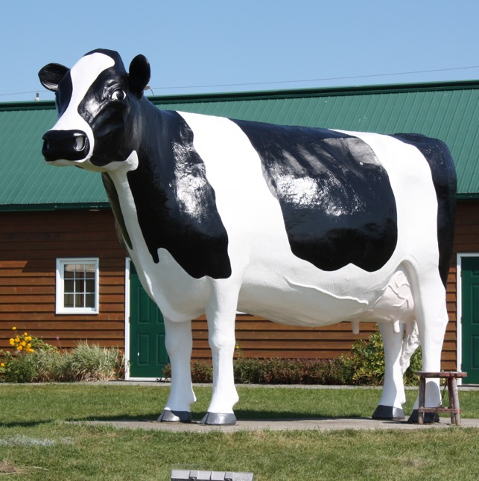

Temiskaming
Shores
2021 North on Tap beer festival has been post-pone until 2022
Hike Devil’s Rock
The Lake Temiskaming Tour: One Lake, Two Provinces, Three Cultures! Drive, RV, or motorcycle
  great way to see the landmarks
  learn about Indigenous Culture
  visit a museum
  enjoy some fantastic cuisine
  Go online, access the passport and enter the contest
https://www.laketemiskaming.com
www.temiskamingshores.ca/covid19

Slide 47
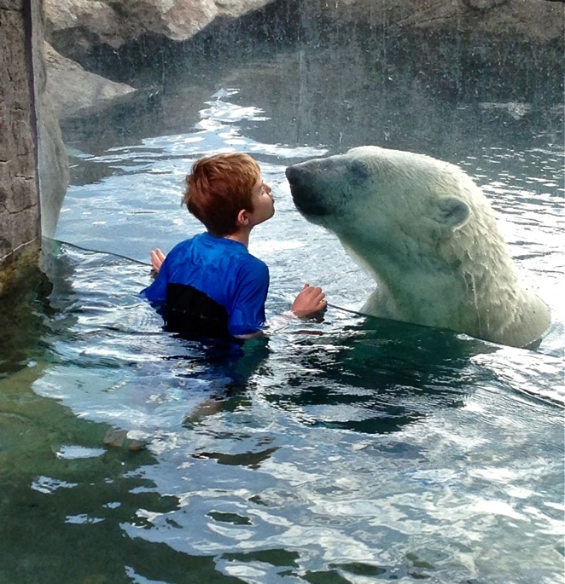
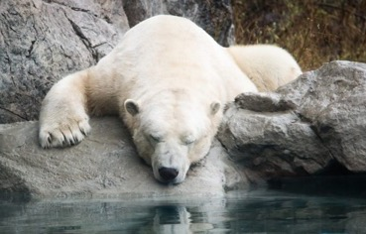
Cochrane
Home of the Canadian Polar Bear Habitat!
  Are currently only available through Facebook, email, and phone 705-272-2327
  Welcome Centre and Viewers Building will be open, but the Heritage Village remains closed
  Masks required in all indoor spaces
The Polar Bear Express train is running again - twice weekly (Mondays and Thursdays)
  Check their website for the safety measures: www.ontarionorthland.ca
  To book call 1-800-461-8558. There is currently no online booking.
The Station Inn hotel is open.
www.cochraneontario.com

Slide 48
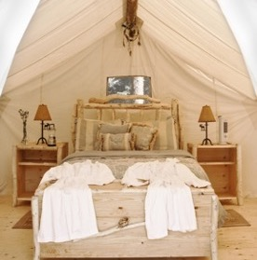

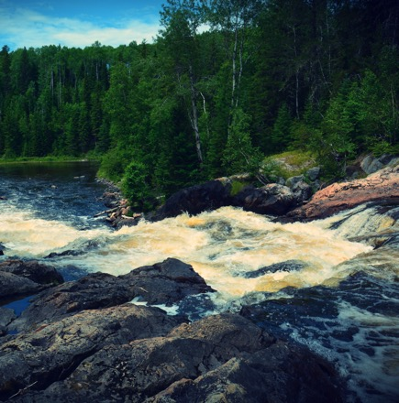
Timmins
By 2001, 67mil troy ounces of gold has been mined from the Porcupine area. For comparison, the well-known Klondike Gold rush produced about 12m troy ounces.
Open For Business
Cedar Meadow Wildlife Tour
Wake Park
Geo Mine Tour
Dream Acre Alpaca Farm
Temporarily closed
Timmins Museum National Exhibition Centre (Re-opening in Stage 3)
Notes:
By 2001, 67 million troy ounces of gold have been mined from the Porcupine area, making it by far the largest gold rush in terms of actual gold produced. For comparison, the well-known Klondike Gold Rush produced about 12 million troy ounces.

Slide 49
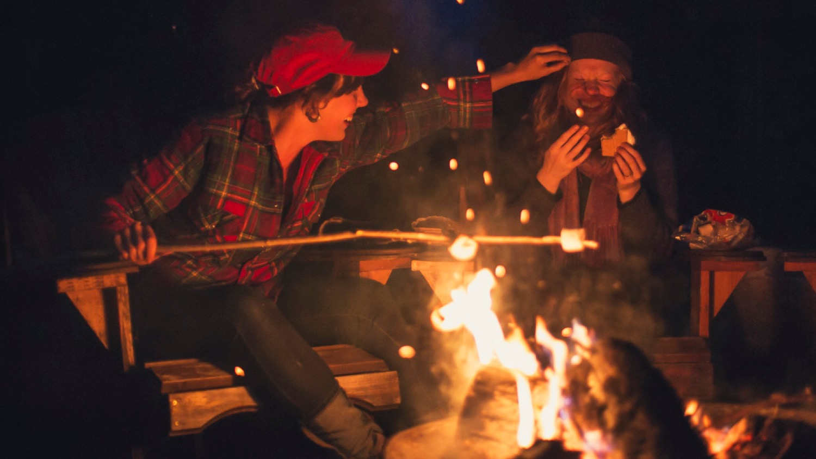

Slide 50
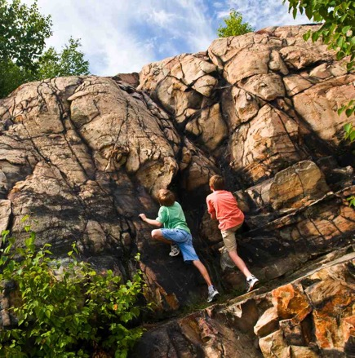
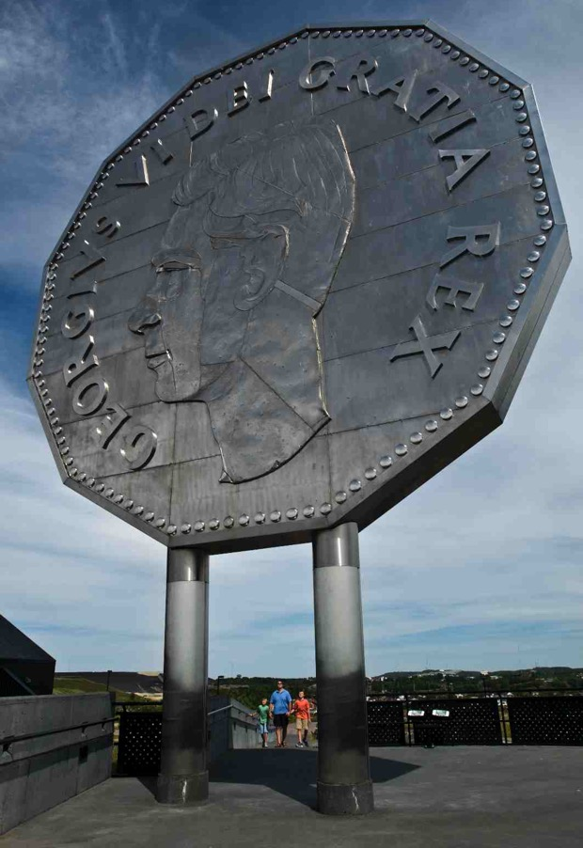
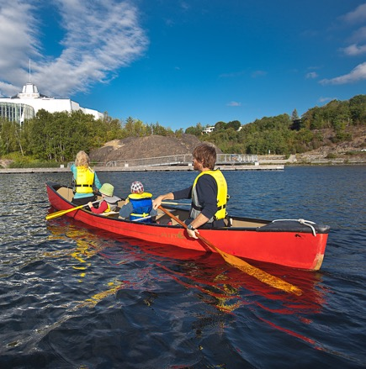
Sudbury
Largest city in Northeastern Ontario
Many restaurants
Theatre
Attractions; Dynamic Earth, Science North (call to visit their website for condensed hours and bookings)
Check the cities website for update to date information-www.greatersudbury.ca/covid

Slide 51
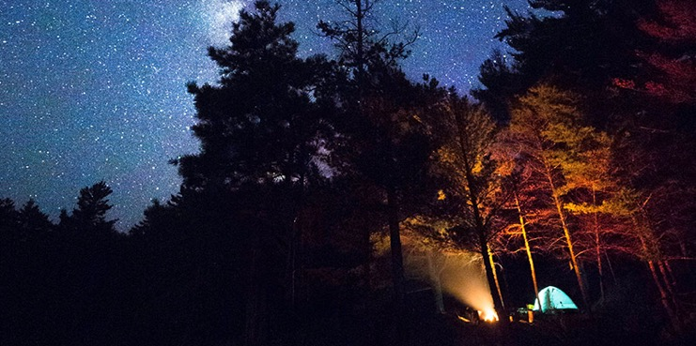
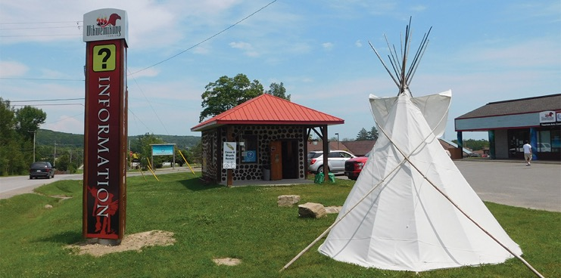
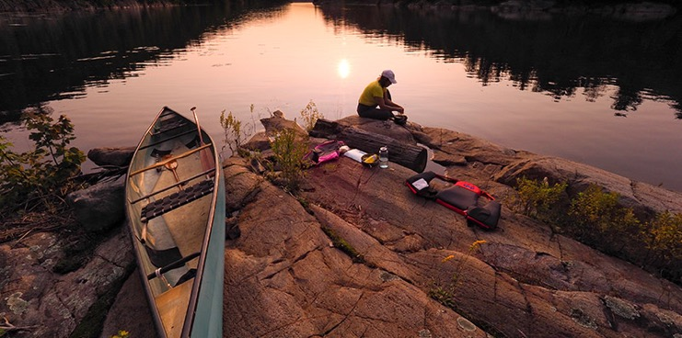
Wiikwemkoong
Unceded Territory
Manitoulin Island- The World’s Largest Freshwater island in the World!!
Take the iconic Chi-Cheemaun Ferry from Tobermory to South Baymouth or drive cross the swing bridge to Little Current. Explore the many sites- Bridal Veil falls, The Cup & saucer Trail, the Beaches of Providence Bay, galleries, cultural experiences, restaurants, The Pow Wow’s, and more.
*In 2021, the ferry service began on June 8th with Covid-19 measures still in place
Destination Manitoulin Island
(formerly known as Manitoulin Tourism Association)
The office located in the South Baymouth marina – 65 Water St
Currently unable to allow visitors inside the building, those wishing for a Traveller’s Guide or other resources will be allowed to received with them proper protocols and sanitation in place
New website launched in October 2020
Contact them directly for more information -705-368-3021 / dmitourism@gmail.com
Wikwemikong Tourism
www.wiikwemkoong.ca/tourism/

Slide 52

Northeastern Ontario has it all!
Encourage visitors to travel and try everything.
Thank you

Slide 53
SECTION 02
Call to action
Participant Poll: Requested Information
What is the most requested information?
1. Accommodations
2. Attractions
3. Food
4. Maps

Slide 54
SECTION 02
Call to action
Participant Poll: Print or Digital?
Do you want the printed versions of the Northeastern Ontario Tourism travel guide and map, or the electronic version this year?
Printed
Electronic

Slide 55

SECTION 02
Getting Information
Community Connections
Northeastern Ontario Tourism
Relationship with other TICS
TIC Hub

Slide 56
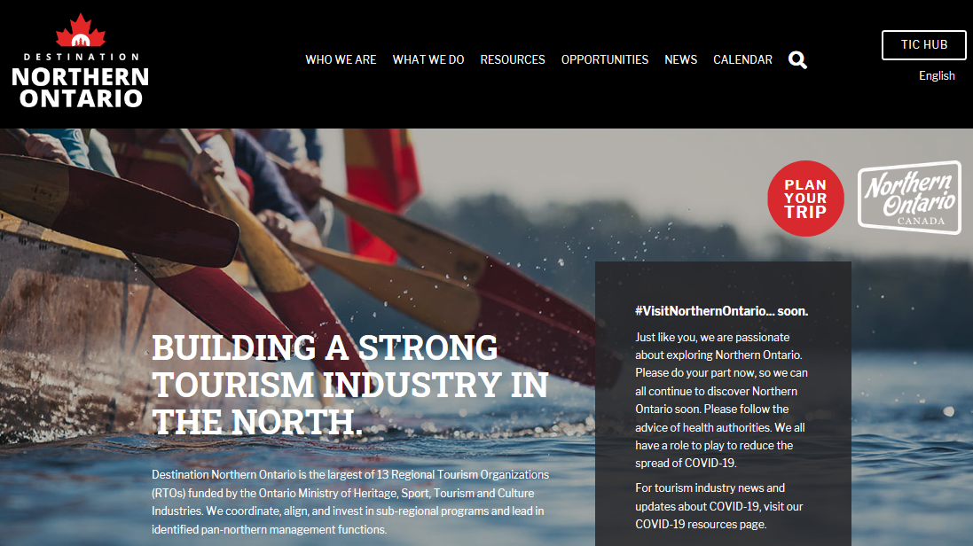

Slide 57

SECTION 03
Working with the Hub
Update your TIC info and community info
Source information on other TICs and destination
Access resources
Share information

Slide 58
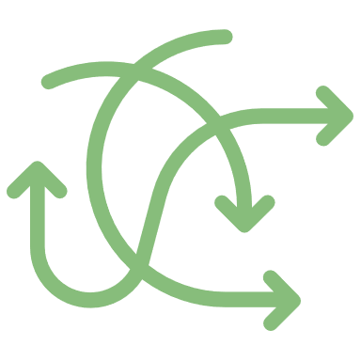
SECTION 03
SECTION THREE
Dealing with Challenges & Difficult Situations
Anticipated business levels

Slide 59
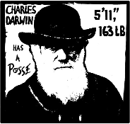
SECTION 03
Change
“Its not the fittest, it’s not the strongest, it’s the one most adaptable to change who will survive”
‘On the origin of species’, Charles Darwin (1809 – 1882)

Slide 60

SECTION 02
Dealing with Change
Be open
Realize it is happening more than ever
Everyone reacts to change differently
Help the visitor navigate the changes
Set yourself up for the flurry of change

Slide 61

Handling Customer Concerns
Accountability
Listen
Show Empathy
Recap the situation
Agree upon a solution
Take Action
Follow up
“The stumbling block becomes the stepping stone when wisely used.”
- Anonymous

Slide 62

SECTION 03
Accountability
Let the customer know that you are going to help them
Build trust and rapport by owning the relationship

Slide 63

SECTION 03
Listen
Focus on the customer
Listen for total meaning
Note all cues
Overt and hidden messages will surface
Ask to further understand

Slide 64
SECTION 03
Enhancing Listening Skills
What does it take?
How can you improve your listening skills?

Slide 65

SECTION 03
Empathy versus Sympathy
Sympathy – Is the state of having similar feelings to someone
Empathy – acknowledges someone’s feelings as being real and valid

Slide 66

SECTION 03
Recap the situation:
Paraphrase
Clarify – ask questions
Repeat the understanding of the situation

Slide 67

SECTION 03
Agree upon a solution:
Discuss options
Involve the customer in the idea phase
Agree upon what would work best

Slide 68

SECTION 03
Take Action and Follow Up:
Based on agreed upon solution take the next steps
Provide updates and any adjustments
Follow-up to close the loop

Slide 69
Recap
Change and Difficult Situations
SECTION 03
Change is ongoing
Customers may have challenges navigating the current situation
Deal with customer concerns
  Accountability
  Listen
  Show Empathy
  Recap the situation
  Agree upon a solution
  Take Action
  Follow up

Slide 70
SECTION 04
SECTION FOUR
Managing Personal
Stress
Anticipated business levels

Slide 71

Stress Causes
SECTION 04
Lack of information
Poor communication
Lack of structure, process
Volume of work
Feeling rushed
Feeling unacknowledged & appreciated
Other?

Slide 72
Stress Signals
SECTION 04
Feeling agitated
Complaining
Withdrawn
Aloof
Frustrated
Angry
Resentful

Slide 73
Managing and Overcoming Stress
SECTION 04
Have a conversation
Consider what is the real issue
Stand back and assess
Put the situation into perspective
Explore ideas to help overcome
Take a break
Take care of yourself

Slide 74

Staying Positive
SECTION 04
Stress with arise
Negative energy will appear
Situations can become overwhelming
Other people could impact your positivity

Slide 75


SECTION 04
OPTIONS
Take on the negativity and let it bring us down
Fuel the negativity
OR
Choose to remain positive
Acknowledge the negativity and turn it around
Choice Time

Slide 76
SECTION 04
We get to Choose
By acknowledging our choices we acknowledge we have options and can choose to remain positive and be a positive influence even when faced with negativity or adversity.

Slide 77

Building Personal Confidence
SECTION 04
Knowing who you are - your beliefs, your values, your goals
Having the self esteem not to let someone else exploit your strengths or your weaknesses
Being very in-tune with your strengths and weaknesses
Knowledge
Experience
Successes
Building confidence in others

Slide 78
Recap
Managing Personal Stress
SECTION 04
Understand stress causes and signals
Develop a plan to manage stress
Recognize you have a choice in relation to negative energy
Build personal confidence by recognizing your strengths and personal attributes

Slide 79
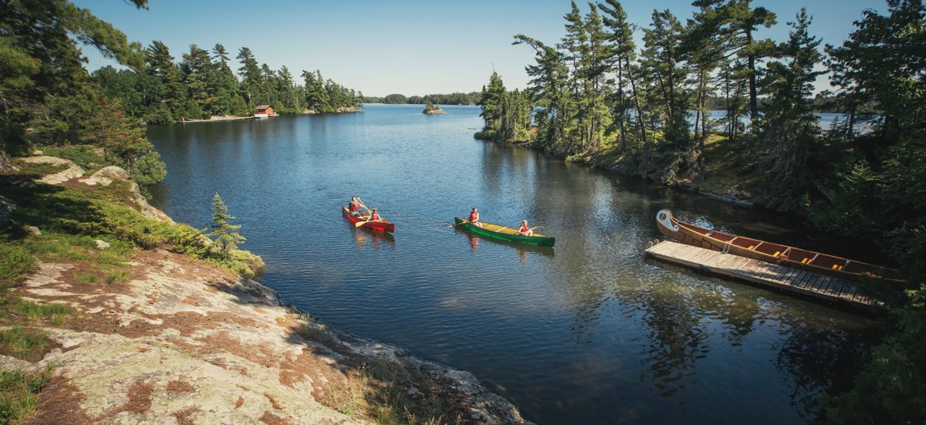
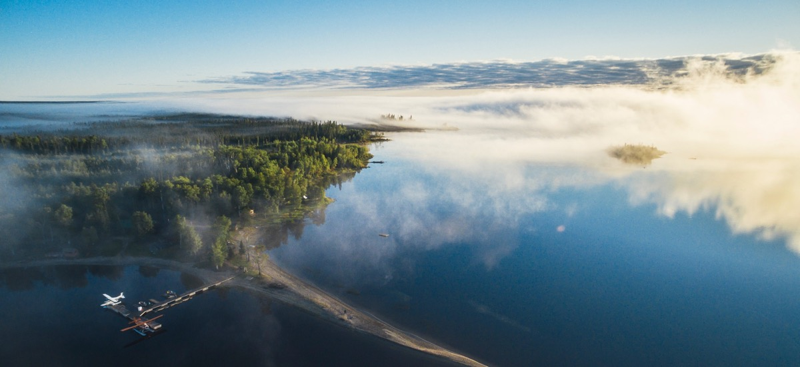
SECTION 05
Share Your Experience
Getting Input

Slide 80
SECTION 05
Build Rapport & Trust
People will want to help you if you helped them
Make it simple
Make it easy
Give them options and choices
Provide clear timelines
Survey and Questionnaire input

Slide 81
Summer 2020
Recap
Understand the new situation
Delve deeper into the customer’s plans
Assist the customer in assuring their needs are met
Approach difficult situations in steps
Deliver, Learn, Celebrate
Manage personal stress

Slide 82
Call to action.
What will you work on right away?
Answer in the chat box.

Slide 83



QUESTIONS?
THANK YOU

