Slide 1


Travel Information Centre Summer 2021 Training – Superior Country
July,2021

Slide 2


Program Outline
Working together
Making a difference through outstanding customer service
COVID safety, restrictions and regional impact
Working Remotely – engaging from a distance
Sunset Country product knowledge
Dealing with stress & uncertainty
Dealing with difficult situations
Your impact on regional marketing through visitor engagement

Slide 3

Take Aways
Deck will be available after the workshop
As we go through the webinar consider what you will need to work on to help visitors in your region

Slide 4

SECTION 01
Introducing
Your name
Your role
One positive aspect as a result of COVID that you experienced in the last 16 months

Slide 5

SECTION 01
Call to action
Participant Poll: TIC Experience
First Summer
1 – 2 years
3 – 5 years
6 years or more

Slide 6

SECTION 01
SECTION ONE
Working Differently
Anticipated business levels

Slide 7
SECTION 01
Think of a positive quality you possess that enhances the guest experience.
Now write this down

Slide 8
SECTION 01
Consider the needs of the guest during this phase COVID-19
Help the guest plan their route and reconfirm availability
Fill product gaps
Relieve concerns
Customize the experience to meet the guest’s needs during the pandemic
Enhance the guest experience by taking a personalized approach to help them
Create great memories
Customer Interactions & COVID-19

Slide 9

SECTION 01
Current Situation for Ontario Residents
Self-isolating for 14 days after all international and US travel
US border closed
Focus on local, provincial travel
Heightened cleaning and hygiene practices and guidelines still in effect
Group size restrictions
Physical distancing – 2 meters
Mask rules in effect

Slide 10

SECTION 01
Current Challenges in Suggesting Travel Experiences
Group size restrictions
Food & Beverage options vary and are more limited
Operating status and opening and hours of sites, attractions & experiences
Health and safety concerns
Some confusion and uncertainty about changing rules and guidelines

Slide 11



SECTION 01
Engaging with the Visitor
Traditional – walk-in with safety measures
Hours of operation may vary
Could be via phone or on-line
Things will likely be different

Slide 12

SECTION 01

Slide 13
Recap
SECTION 01
Working Differently
Things will be different
Traveller have new needs and new concerns
Your input is vital – on the ground intel
Engagement might be different
Change is ongoing
Rules changing every 21 days
Notes:
How do we form a strong positive attitude?

Slide 14

SECTION 02
Service Delivery & Guest Interaction
Anticipated business levels

Slide 15

SECTION 02
Call to action
How long does it take to make a first impression?
3 seconds
10 seconds
30 seconds
One minute

Slide 16

SECTION 02
First Impression
How long does it take?
About 3 seconds

Slide 17

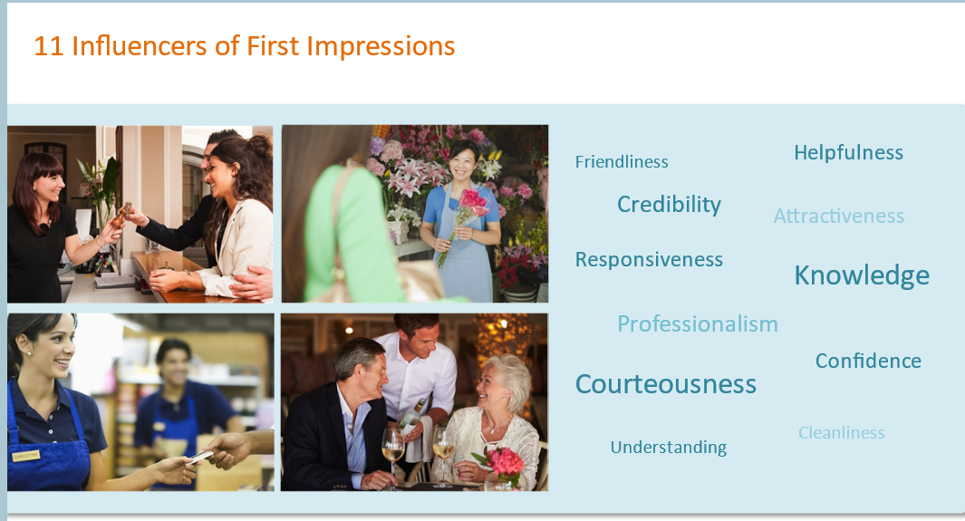
First Impressions
SECTION 02
From OTEC online TIC program

Slide 18

First Impressions – In person
SECTION 02
55% = appearance
38% = tone
7% = words

Slide 19

First Impressions – On the phone
SECTION 02
80% = tone
20% = words

Slide 20
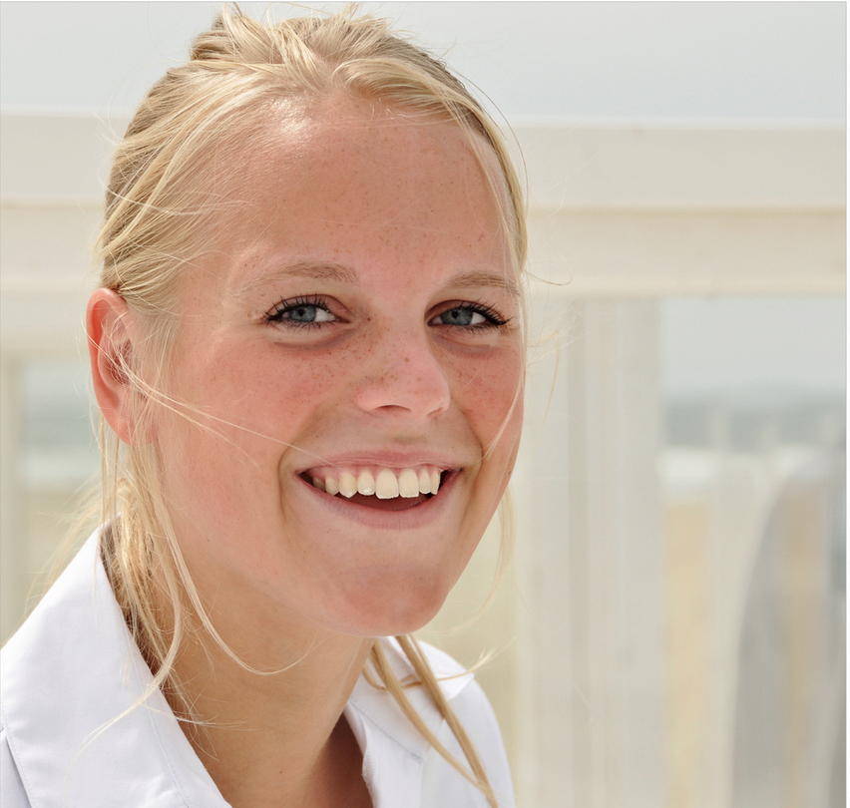
When looking at appearance, tone and words, what is the dominant key influencer?
Positive Attitude

Slide 21

Positive Attitude
SECTION 02
“Attitude.....fuels my fire or assaults my hope. When my attitude’s right, there’s no barrier too high, no valley too deep, no dream too extreme, no challenge too great for me.” Charles Swindoll
Notes:
How do we form a strong positive attitude?

Slide 22

SECTION 02

Slide 23


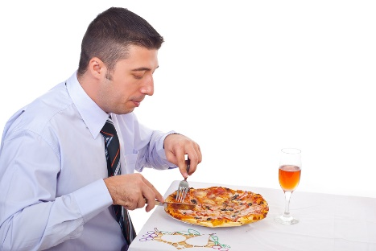




SECTION 02
What influences your attitude both positively and negatively?

Slide 24

Meet
Damien
SECTION 02
https://unsplash.com/@alessiozaccaria
Notes:
Think of a customer from hell.
Let’s name him/her. Horns, jagged teeth, flight is late, tired. You get him on the TELEPHONE. His call has been transferred to you (his call was put on hold, dropped and now calling you to yell)
You have several choices. The WORST choice is getting angry back. Damion puts all this energy on you and you take it on. How does this impact you?
Header:
DAMION gave his ‘crap’ to you
YOU have him your day
COLLEAGUES – now you pass this onto you colleagues
FAMILY – you bring it home to the ppl you love the most (including your dog) by putting it on them.
Multiplier effect. Look how much power Damion has on you! You’re affected co-workers, family, etc.. YOU TOOK THIS NEGATIVE ENERGY!
NEXT BEST SCENARIO…you do your best to block it out
BEST SCENARIO…Turn that energy around. Empathize with them, tone is calm. You can influence the outcome and how the guest feels. IE groceries – extra bags. Now look at the multiplier effect of that…spread the word, neutralize it!

Slide 25


SECTION 02
OPTIONS
Take on the negativity and let it bring us down
Fuel the negativity
OR
Choose to remain positive
Acknowledge the negativity and turn it around
Choice Time

Slide 26
SECTION 02
Between stimulus and response there is a space…..and within the space lies our freedom and power to choose our response. Within that response lies our freedom and growth…..
Viktor Frankl

Slide 27

SECTION 02
By acknowledging our choices, we acknowledge we have options and can choose to remain positive and be a positive influence even when faced with negativity or adversity.

Slide 28
SECTION 02

Slide 29

SECTION 02
Perceptions
Perceptions and visitor interactions

Slide 30

What do you see?
SECTION 02

Slide 31

What word do you see?
SECTION 02

Slide 32

How many legs?
SECTION 02

Slide 33
SECTION 02
Perceptions
We will all see if differently
If I understand a little bit more about you, I may begin to understand your perspective….your perception

Slide 34

Understanding self, understanding others and connecting
SECTION 02
Present a quick, easy way to quickly assess other’s preferred communication method
Provide some tools to help connect

Slide 35
Relationship versus Task Focused
SECTION 02
Intuitive
Prefers working on projects with others
Initiates conversations by starting a conversation
Friendly, open approach
Sometimes unclear on what they want
Focus on relationship
Focus on telling the story
Positive and optimistic
Friendly and engaging
Open to possibilities
Analytical
Enjoys and often prefers working on solo projects
Initiates conversations based on the need or situation
Focussed on the task at hand
Clear direct approach and ask for what they want
Focus on facts
Focus on the desired outcome
Concerned with the issue at hand
Formal and practical
Sticks to the plan

Slide 36

SECTION 02
What do you see in this image?

Slide 37
Introverted versus Extroverted
SECTION 02
Comfortably engages in conversation with strangers
Mills with ease in a large group
Talkative
Enjoys larger social gatherings and high energy parties
Speaks to generate and flush out ideas – bounces ideas around
Outspoken and bold
Direct approach
Prefers talking over listening
Involved
Energized by being around a lot of people
Tends to avoid gatherings where they don’t know others
Less comfortable in larger group
Quieter
Prefers smaller, more intimate social gatherings
Thinks about the idea, formulate thoughts and then speaks
Thoughtful
Gentler, thought out approach
Strong listening skills
Observant
Often drained by being around a lot of people

Slide 38
SECTION 02
Characteristics
  Likes control – “they’re in charge”
  Direct
  Assertive
  Purposeful
  Efficient
  Decisions are quick and decisive
  Firm actions and decisions
  Get to the finish line – get the job done
Red Energy – Extroverted/
Task

Slide 39
SECTION 02
Characteristics
  Persuasive
  Use intuition to guide decisions
  Relationship focused
  Personal, informal approach
  Optimistic
  Engage others with ease
  Charming
  Like quick decisions and then move into action
Yellow Energy - Relationship/
Extroverted

Slide 40
SECTION 02
Characteristics
  Work cohesively with others
  Caring
  Encouraging
  Patient
  Like close personal relationships
  Considerate
  Empathetic
  Happy, well liked
  Need to be liked and accepted
Green Energy – Relationship/
Introverted

Slide 41
SECTION 02
Characteristics
  Cautious actions and decisions
  Asks many questions about specific details
  Formal
  Likes organization and structure
  Comfortable working alone
  Logical
  Detailed
  Good problem-solving skills
Blue Energy – Introverted/Task

Slide 42

How to Recognize
SECTION 02
Quick assessments on style
  Introverted?
  Extraverted?
  Relationship Focus?
  Task Focus?

Slide 43
SECTION 02
Relationship focused
Relationship/
Extraverted
Relationship/
Introverted
Extraverted
Introverted
Task/
Extraverted
Task/
Introverted
Task Focused

Slide 44
SECTION 02
Annotate your dominant preference
Relationship focused
Relationship/
Extraverted
Relationship/
Introverted
Extraverted
Introverted
Task/
Extraverted
Task/
Introverted
Task Focused

Slide 45
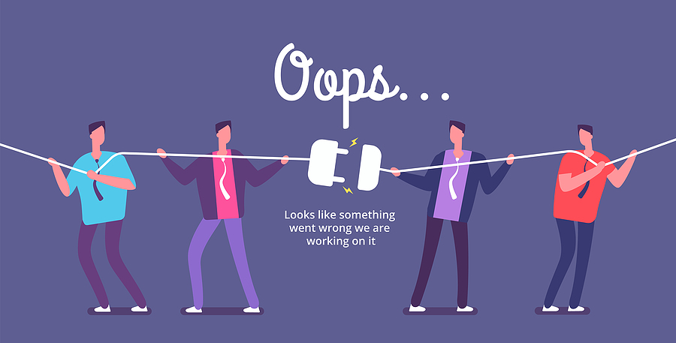
Perceptions and a Disconnect
SECTION 02

Slide 46
Revisiting your one word…
SECTION 02
Think of a positive quality you possess that enhances the guest/customer/client experience.

Slide 47
SECTION 02
Connecting with the Traveller
01
Ask
Inquire into the overall travel experience
Ask open-ended questions
Plan your questions in advance – what do you need to know in order to guide and help the customer?

Slide 48
SECTION 01
SECTION 02
Seek to truly understand – get the whole picture
Delve deeper
Uncover overt and hidden needs
Really understand the guest’s wants, needs AND concerns
02
Understand
Uncover concerns and perceived challenges

Slide 49
SECTION 02
Stay on top of news and changes (as much as you can)
Provide your knowledge and expertise
Guide the traveller based on what you have learned about them
03
Deliver
Provide knowledge & expertise

Slide 50
SECTION 02
Attributes & Qualities
Patience
Kindness
A Sense of Humour
Empathy
Flexibility
Adaptability
Approachability
Relationship Building Skills
Creativity
Resourcefulness
Listening Skills
Destination Knowledge
Ability to Diffuse a Situation

Slide 51
SECTION 02
Call to action – tick mark beside the one quality you wish to work on this summer
Patience
A Sense of Humour
Empathy
Flexibility
Adaptability
Kindness
Approachability
Relationship Building Skills
Resourcefulness
Creativity
Ability to Diffuse a Situation
Listening Skills
Destination Knowledge

Slide 52
SECTION 02
RECAP
Connecting with the Traveller
Assess communication preference
Choose how you will respond to negative energy
Ask, Understand, Deliver

Slide 53

Welcome to Superior Country
SEP Student Online Training Session

Slide 54


Slide 55
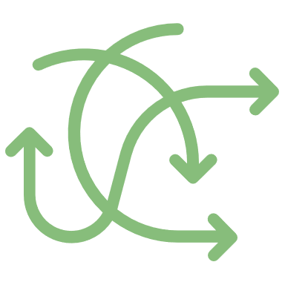
SECTION 03
SECTION THREE
Dealing with Challenges & Difficult Situations
Anticipated business levels

Slide 56
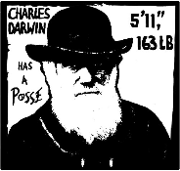
SECTION 03
Change
“Its not the fittest, it’s not the strongest, it’s the one most adaptable to change who will survive”
‘On the origin of species’, Charles Darwin (1809 – 1882)

Slide 57

Handling Customer Concerns
Accountability
Listen
Show Empathy
Recap the situation
Agree upon a solution
Take Action
Follow up
“The stumbling block becomes the stepping stone when wisely used.”
- Anonymous

Slide 58

SECTION 03
Accountability
Let the customer know that you are going to help them
Build trust and rapport by owning the relationship

Slide 59

SECTION 03
Listen
Focus on the customer
Listen for total meaning
Note all cues
Overt and hidden messages will surface
Ask to further understand

Slide 60
SECTION 03
Enhancing Listening Skills
What does it take?
How can you improve your listening skills?

Slide 61

SECTION 03
Empathy versus Sympathy
Sympathy – Is the state of having similar feelings to someone
Empathy – acknowledges someone’s feelings as being real and valid

Slide 62

SECTION 03
Recap the situation:
Paraphrase
Clarify – ask questions
Repeat the understanding of the situation

Slide 63

SECTION 03
Agree upon a solution:
Discuss options
Involve the customer in the idea phase
Agree upon what would work best

Slide 64

SECTION 03
Take Action and Follow Up:
Based on agreed upon solution take the next steps
Provide updates and any adjustments
Follow-up to close the loop

Slide 65
Recap
Change and Difficult Situations
SECTION 03
Change is ongoing
Customers may have challenges navigating the current situation
Deal with customer concerns
  Accountability
  Listen
  Show Empathy
  Recap the situation
  Agree upon a solution
  Take Action
  Follow up

Slide 66
SECTION 04
SECTION FOUR
Managing Personal
Stress
Anticipated business levels

Slide 67

Stress Causes
SECTION 04
Lack of information
Poor communication
Lack of structure, process
Volume of work
Feeling rushed
Feeling unacknowledged & appreciated
Other?

Slide 68
Stress Signals
SECTION 04
Feeling agitated
Complaining
Withdrawn
Aloof
Frustrated
Angry
Resentful

Slide 69
Managing and Overcoming Stress
SECTION 04
Have a conversation
Consider what is the real issue
Stand back and assess
Put the situation into perspective
Explore ideas to help overcome
Take a break
Take care of yourself

Slide 70
SECTION 04
By acknowledging our choices we acknowledge we have options and can choose to remain positive and be a positive influence even when faced with negativity or adversity.
We get to Choose

Slide 71

Building Personal Confidence
SECTION 04
Knowing who you are - your beliefs, your values, your goals
Having the self esteem not to let someone else exploit your strengths or your weaknesses
Being very in-tune with your strengths and weaknesses
Knowledge
Experience
Successes
Building confidence in others

Slide 72

Recap
Managing Personal Stress
SECTION 04
Understand stress causes and signals
Develop a plan to manage stress
Recognize you have a choice in relation to negative energy
Build personal confidence by recognizing your strengths and personal attributes

Slide 73
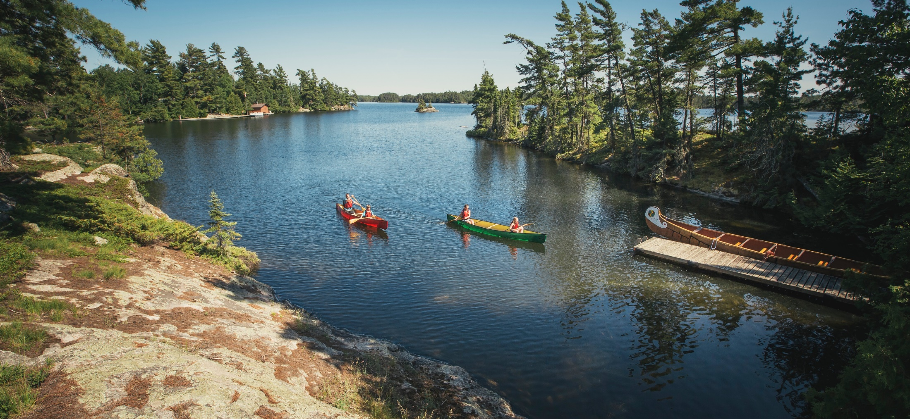

SECTION 05
Share Your Experience
Getting Input

Slide 74
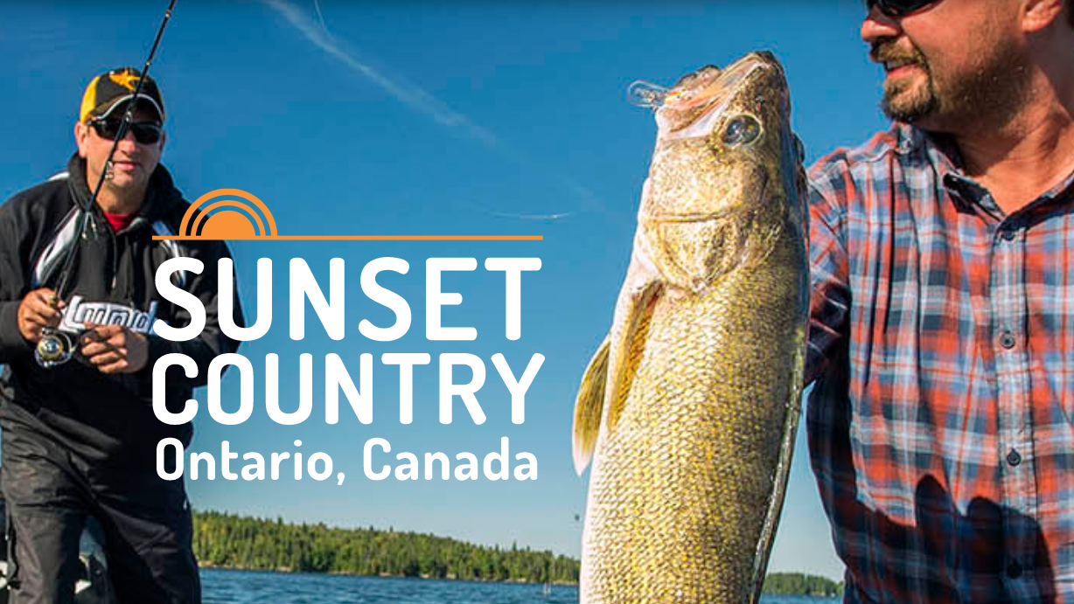
Visitor Survey
The Purpose – to better understand the visitor’s travel plans in the region
The Outcomes - capture input on an iPad (which are on their way to you) and communities get input to help the overall tourism experience.

Slide 75
SECTION 05
Build Rapport & Trust
People will want to help you if you helped them
Make it simple
Make it easy
Give them options and choices
Provide clear timelines
Survey and Questionnaire input

Slide 76
Summer 2021
Recap
Understand the new situation
Delve deeper into the customer’s plans
Assist the customer in assuring their needs are met
Approach difficult situations in steps
Deliver, Learn, Celebrate
Manage personal stress

Slide 77
Call to action.
What will you work on right away?
Answer in the chat box.

Slide 78



QUESTIONS?
THANK YOU

